Slide 1
Proposal to the FOMC
Dual Mandate Performance
Economic Headwinds
Our Policy: Explicit Commitment to Contingent Quantitative Easing

Slide 2
Current Economic Situation & Dual Mandate Performance

Slide 3
Source: Bureau of Economic Analysis; Congressional Budget Office

Slide 4
Underemployment & Unemployment Elevated
Source: Bureau of Labor Statistics

Slide 5
Long-Term Unemployment Especially Problematic
Source: Bureau of Economic Analysis; Congressional Budget Office
Notes:
Change to the side

Slide 6
Inflation Remains Stable
Source: Bureau of Economic Analysis; Federal Reserve

Slide 7
Inflation Expectations are Well Anchored
Lehman Brothers Bankruptcy
Source: Federal Reserve; Federal Reserve Bank of Philadelphia

Slide 8
Dual Mandate Performance
Sizable GDP Gap
Unemployment Exceptionally High
Inflation Well Anchored Around 2% Target

Slide 9
Economic Headwinds

Slide 10
Source: Thomson Reuters/University of Michigan

Slide 11
Investors Lack Confidence in Corporate Debt
Source: Board of Governors of the Federal Reserve

Slide 12
Businesses Lack Confidence in Recovery Prospects
Source: Bank of America Merrill Lynch, Board of Governors of the Federal Reserve
Notes:
Change to title – also note ex-aircraft

Slide 13
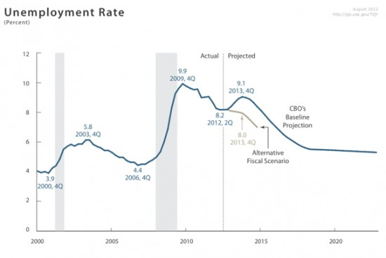
“Fiscal Cliff” Poses Broad Macroeconomic Risks
Source: Congressional Budget Office

Slide 14
European Debt Crisis Under Control, For Now
Source: International Monetary Fund

Slide 15
Source: Bureau of Economic Analysis
Notes:
Change title

Slide 16
Source: Census Bureau

Slide 17
Conventional Monetary Policy
Interest Rate Hit Lower Bound
Unconventional Monetary Policy
Asset Purchases
Forward Guidance
Sluggish Economy

Slide 18
Source: Board of Governors of the Federal Reserve
Notes:
1

Slide 19
Source: Standard & Poor’s

Slide 20
Conclusion
Weak Recovery Despite Accommodative Monetary Policy
Further Stimulus needed

Slide 21
Current Fed Policy:
“If the outlook for the labor market does not improve substantially, the Committee will continue its purchases of agency mortgage-backed securities, undertake additional asset purchases, and employ its other policy tools as appropriate until such improvement is achieved in a context of price stability.”
Source: FOMC Statement, October 24th 2012

Slide 22
Our Policy:
“If the unemployment rate remains above 7% and core inflation remains below 3%, the Committee will continue its purchases of agency mortgage-backed securities, undertake additional asset purchases, and employ its other policy tools as it sees fit. ”

Slide 23
Policy Goals:
Clarify and Commit Fed to Further Stimulus
Provide Stability to Offset Uncertainty Over Fiscal Policy and Other Macroeconomic Risks
Induce Confidence in the Recovery to Encourage Additional Investment and Consumption

Slide 24
Further Guidance Occurs If:
Inflation Rises from a Supply Shock
Natural Rate of Unemployment is Higher than Currently Projected
Our Policy is Successful and Unemployment Falls Below 7%

Slide 25
Inflation will remain controlled
Long Term Inflation Target of 2%
Temporary Nature of Policy

Slide 26
Summary:
Economic Factors Warrant Further Monetary Stimulus
Increased Commitment and Clarity of Conditional QE Boosts Recovery Confidence
Inflation Remains Under Control

