Slide 1
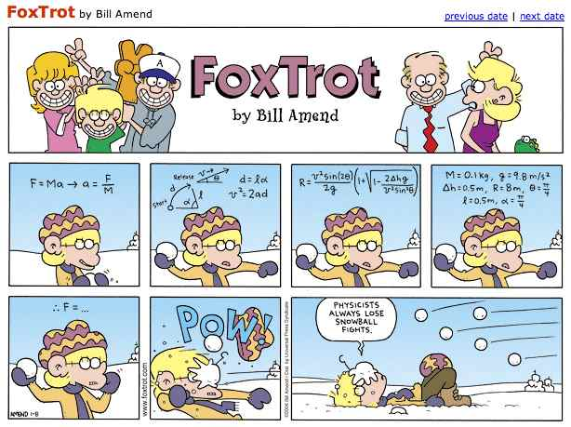
PHYS16 – Lecture 1
Introduction
Wednesday, September 8, 2010

Slide 2
Agenda
Register clickers
Introduction to course and syllabus
Meet and greet activity
Before next time

Slide 3
Register clickers
Can you correctly answer A to this question?
Yes
No
http://kookaburra.com.au

Slide 4
Syllabus - Logistics

Slide 5
Syllabus – Course Materials
Text
Connect Access Card
PRS transmitter
Laboratory Manual – First day of lab
Laboratory Notebook – First day of lab
Lecture materials
Pen
Scientific Calculator
Notebook

Slide 6
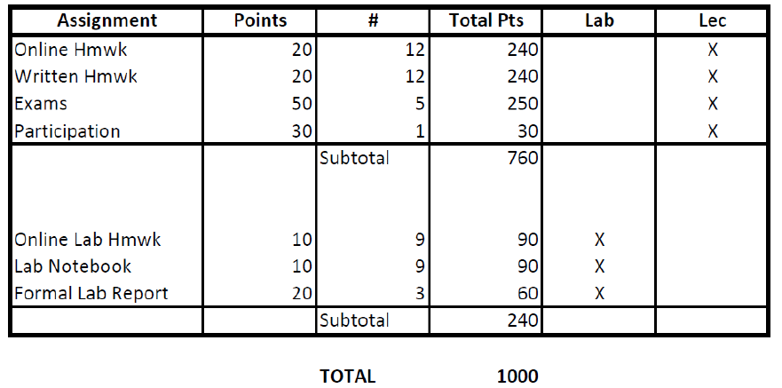
Syllabus - Grading

Slide 7
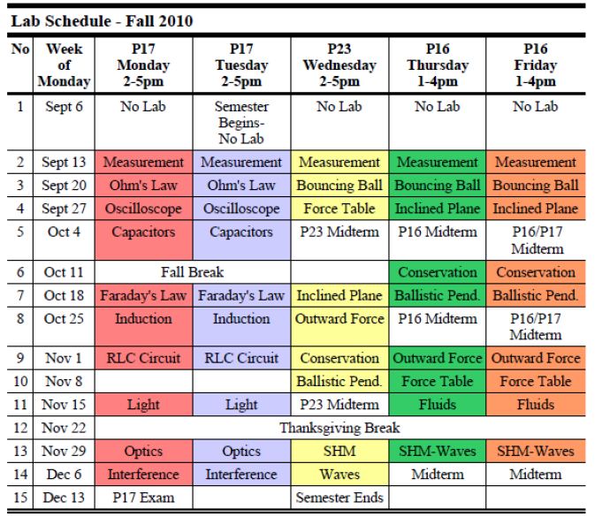
Syllabus - Labs

Slide 8
Syllabus – Code of Conduct
Homework
Work together in study groups
Answer the questions on your own
Only enter a correct answer if you know how to do the problem
PRS
Work together or answer questions on your own where noted
Labs
Work together as partners but should each take your own data
Write in your on lab notebook
Write your own formal reports
Exams
Take-home are open note, In-class are not
Always answer questions on your own

Slide 9
Meet and Greet Activity
Get up and let’s meet everyone!

Slide 10
Meet and Greet Activity
Form study groups 3-6 people
Form lab partners

Slide 11
For next time…
Get the course materials
Clicker
Text
Connect Access card and sign in to our course
Download files off of course website
Bring to class
Clicker
Calculator
Notebook for notes/handouts

