Slide 1
PHYS16 – Lecture 12
Review and Momentum
October 6, 2010

Slide 2
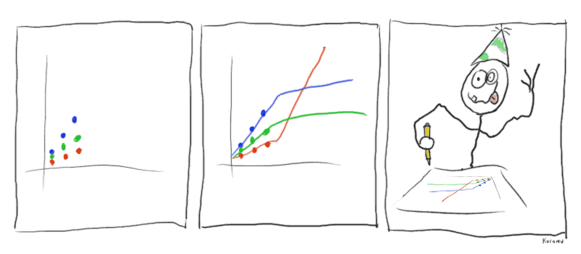
Ch. 1 Math Overview
http://niceskybox.files.wordpress.com/2007/12/duhlines.gif

Slide 3
Review: Ch. 1 Math Overview
1. For each value list the number of significant digits:
A) 234
B) 100.001
C) 1,100
D) 0.007
E) 0.00330
F) 143.5*2
G)34/9.8
H)131-0.0001
3
6
2
1
3
1 (Answer = 3E2)
2 (Answer = 3.5)
3 (Answer = 131)

Slide 4
Review: Ch. 1 Math Overview
2. For each value list the number in scientific notation:
A) 44,000
B) 0.00007
C) 900
D) 0.00533
E) 0.00660
F) 430.5
G)88,000,000
H)88,010,000
4.4E4
7E-5
9E2
5.33E-3
6.60E-3
4.305E2
8.8E7
8.801E7

Slide 5
Review: Ch. 1 Math Overview
3. Convert 0.1 m² to cm²:
A) 1E3 cm²
B) 1E1 cm²
C) 1E0 cm²
D) 1E-5 cm²
E) 1E-3 cm²

Slide 6
Review: Ch. 1 Math Overview
4. The initial velocity of a projectile is 2.0 m/s at an angle of 25 degrees with respect to the ground. What is its velocity component perpendicular to the ground?
A) 2 mph
B) 0.8 mph
C) 1.8 mph
D) 1 mph
E) 0.9 mph

Slide 7
Ch. 2 Motion in 1D

Slide 8
Review: Ch. 2 Motion in 1D
1. Velocity is given by the equation, v=(3.0)t³+9.0. What is acceleration at t=2.0 s?
A) 81 m/s²
B) 30 m/s²
C) 36 m/s²
D) 45 m/s²

Slide 9
Review: Ch. 2 Motion in 1D
2. You throw a ball up with an initial velocity of 2 m/s, how long does it take to get to the top of the arc?
A) 0.204 s
B) 0.2 s
C) 0 s
D) 1 s

Slide 10
Review: Ch.2 Motion in 1D
3. If you have a velocity that is linearly increasing with time, then acceleration is:
A) linear
B) parabolic
C) constant and positive
D) constant and negative

Slide 11
Review: Ch.2 Motion in 1D
4. Velocity is given by the graph shown below. What is the displacement at 10.0 s?
A) 34
B) 3.5 m
C) 33 m
D) -1 m
E) 38 m
10.0
V (m/s)
(5,5)
(7,2)
5.0
(10,2)
5.0
10.0
t (s)

Slide 12
Ch. 3 Motion in 2D

Slide 13
Review: Ch.3 Motion in 2D
In the motion of a projectile, at the top of the arc, the following variables are not zero:
I. a_{y} II.v_{y} III.a_{x} IV. a
A) I and II
B) II and III
C) II, III, and IV
D) I and III
E) I and IV

Slide 14
Review: Ch.3 Motion in 2D
2. For 2D motion, motion in x and y are:
A) coupled
B) related
C) independent
D) interchangeable
E) None of the above

Slide 15
Review: Ch.3 Motion in 2D
3. You throw a ball from a height of 1.0 m at an angle of 37 degrees with respect to the ground and a speed of 2.0 m/s. When the ball reaches 1.0 m again its speed will be what value?
A) 0 m/s
B) 1.6 m/s
C) 1.0 m/s
D) 1.2 m/s
E) 2.0 m/s

Slide 16
Review: Ch.3 Motion in 2D
4. A plane is pointed north going 310 mph. A crosswind at 45 mph starts to blow at 37 degrees south of east. What is the plane’s velocity relative to the earth?
A) 300 mph at 90 degrees north of east
B) 280 mph at 87 degrees north of east
C) 355 mph at 90 degrees north of east
D) 290 mph at 83 degrees north of east
E) 280 mph at 85 degrees north of east

Slide 17
Ch. 4 Force

Slide 18
Review: Ch.4 Force
1. The Lingenfelter corvette going 0 to 27 m/s in 1.92 s is an example of:
A) Mechanical Equilibrium
B) Static Equilibrium
C) Dynamic Equilibrium
D) A and C
E) None of the above

Slide 19
Review: Ch.4 Force
2. If the Lingenfelter corvette goes from zero to 27 m/s in 1.92 s and has a mass of 1.5 metric tons, what is the net force on the car?
A) 21.1 kN
B) 21 kN
C) 20 kN
D) 22 kN
E) 10 kN

Slide 20
Review: Ch.4 Force
3. Now, if the Lingenfelter corvette goes from zero to 27 m/s in 1.92 s up a 15 degree incline and has a mass of 1.5 metric tons, what is the net force on the car?
A) 21.1 kN
B) 21 kN
C) 20 kN
D) 22 kN
E) 10 kN

Slide 21
Review: Ch.4 Force
4. A 0.4 kg mass hangs from a rope. The rope travels up to the ceiling and goes around a pulley and then back down where a person is holding the other end. The rope and pulley are massless. How much force does the person have to exert to keep the mass going up at a constant speed of 2 m/s?
A) 6 N
B) 1 N
C) 5 N
D) 4 N
E) 2 N

Slide 22
End of Review!!

Slide 23
Momentum
Momentum = mass times velocity
↑ mass , then ↑ momentum
↑ velocity, then ↑ momentum
Vector quantity
Units are (kg∙m/s)

Slide 24
Man or Mouse?

Slide 25
Man or Mouse?
A 50 kg man and a 1 kg mouse are walking together at 1 m/s, who has more momentum?
A 50 kg man is stopped to watch a 1 kg mouse walk a tight rope, who has more momentum?
Through genetic research our mouse has gained another 3 kg and sped up to an incredible speed of 11 m/s, if the man is still walking who has more momentum?

Slide 26
Impulse
Impulse describes the change in momentum
Good for describing what happens at a collision
Examples:
What is momentum of 0.5 kg ball dropped from 5 m just before it hits the floor?
If the velocity after it hits the floor is +8 m/s upward, what is the impulse?
If the interaction lasts 0.01 s, what was the average Force?

Slide 27
Momentum and Newton’s Laws
In Newton’s second law F≠ ma!

Slide 28
Momentum and Newton’s Laws
According to Newton’s third law momentum is conserved

