Slide 1
PHYS16 – Lecture 14
Momentum and Collisions
October 8, 2010

Slide 2
Momentum
Momentum = mass times velocity
↑ mass , then ↑ momentum
↑ velocity, then ↑ momentum
Vector quantity
Units are (kg∙m/s)

Slide 3
Man or Mouse?

Slide 4
Man or Mouse?
A 50 kg man and a 1 kg mouse are walking together at 1 m/s, who has more momentum?
A 50 kg man is stopped to watch a 1 kg mouse walk a tight rope, who has more momentum?
Through genetic research our mouse has gained another 3 kg and sped up to an incredible speed of 11 m/s, if the man is still walking who has more momentum?

Slide 5
Why do we care about Momentum?
Three ways to convince you
A Rocket?
A ball in your face?
The age old question: Superball vs. Basketball…

Slide 6
Why do we need Momentum?
Reason 1: In Newton’s second law F≠ ma!

Slide 7
Why do we need Momentum?
Reason 2: What happens during a collision?
Impulse (J) describes the change in momentum
Good for describing what happens at a collision
Examples:
Ball is dropped, just before floor its speed is 3 m/s downward. If the velocity after it hits the floor is +8 m/s upward, what is the impulse?
If the interaction lasts 0.01 s, what was the average Force?

Slide 8
During Collisions…
Baseball
Soccer ball
Water balloon?

Slide 9
Why do we need Momentum?
Reason 3: What happens before and after a collision?
According to Newton’s third law momentum is conserved in an isolated system

Slide 10
Before and After Collisions…
Superball vs. Basketball
Drop a superball and basketball together
Both travel at the same velocity
Basketball hits ground and bounces back
Basketball and superball collide and superball is now traveling up
Superball speed was higher after collision than before collision so now bounces very high!
Homework problem on how high it bounces…

Slide 11
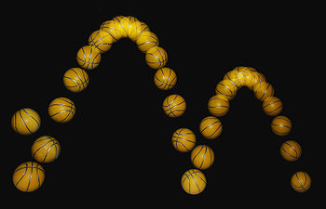
Elastic and Inelastic Collisions
Perfectly Elastic – no losses due to the interaction
Objects bounce perfectly off one another
Ex. pool balls, gliders on air track
Inelastic – there are losses
Objects don’t perfectly bounce
Ex. basketball hitting ground
Perfectly Inelastic – objects adhere
Ex. clay ball with floor

Slide 12
2D Collisions
Need to add 2D vectors
Assume masses of two objects equal
Before
After
A
B
C

Slide 13
2D Collisions – Predict vectors, assume masses are equal
A
B

Slide 14
2D collisions – How to solve problems
Separate vectors into x and y components
Solve two equations
Conservation of momentum in x and
Conservation of momentum in y

