Slide 1
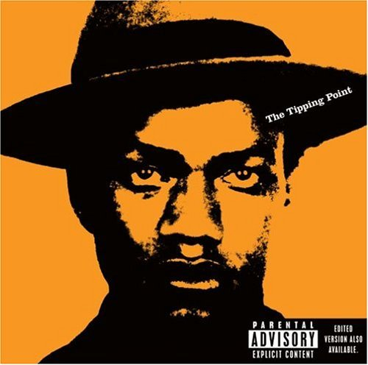
Why does “conscious” hip-hop matter?

Slide 2
conscious |ˈkän ch əs|
adjective
aware of and responding to one’s surroundings; awake.
having knowledge of something; aware
(conscious of) painfully aware of; sensitive to
concerned with or worried about a particular matter
Notes:
Important factors:
Media exposure and access
International influence
subject matter: conscious hip-hop defined as subgenre focusing on social issues, not necessarily overtly political, but discusses social themes/conflicts

Slide 3
"They've got their little categories, like 'conscious’ and 'gangsta'. It used to be a thing where hip-hop was all together. Fresh Prince would be on tour with N.W.A… It used to be one type of nigga; now it’s two. There is so much more dimension to who we are… The real joy is when you can kick it with everyone. That’s what hip-hop is all about… they keep trying to slip the ‘conscious rapper’ thing on me… And they try to get me because I’m supposed to be more articulate, I’m supposed to not be like the other Negroes… I’m not going out like that, man.”
- Mos Def
Notes:
FULL QUOTE: Mos Def, praised as one of the leaders of "conscious rap," refuses to think in such narrow terms. "They've got their little categories, like 'conscious' and 'gangsta,'" says Mos Def. "It used to be a thing where hip-hop was all together. Fresh Prince would be on tour with NWA. It wasn't like, 'You have got to like me in order for me to like you.' That's just some more white folks trying to think that all niggas are alike, and now it's expanded. It used to be one type of nigga; now it's two. There is so much more dimension to who we are. A monolith is a monolith, even if there's two monoliths to choose from." Mos Def sees the danger, however, in having only one dimension of the black experience get airplay, which in present terms is usually of the bling-bling or thug variety. "I ain't mad at Snoop. I'm not mad at Master P. I ain't mad at the Hot Boyz. I'm mad when that's all I see. I would be mad if I looked up and all I saw on TV was me or Common or the Roots, because I know that ain't the whole deal. The real joy is when you can kick it with everyone. That's what hip-hop is all about." [...] Mos Def is careful to avoid accepting the praise -and the typecasting- of corporate interests that deny the complexity of black identity and culture. "They keep trying to slip the 'conscious rapper' thing on me," he says. "I come from Roosevelt Projects, man. The ghetto. I drank the same sugar water, ate hard candy. And they try to get me because I'm supposed to be more articulate, I'm supposed to be not like the other Negroes, to get me to say something against my brothers. I'm not going out like that, man."

Slide 4
So, if “the real joy is when you can kick it with everyone,” does being a conscious hip-hop artist mean having knowledge of other cultures’ hip-hop scenes? Sampling? Collaboration?

