Slide 1
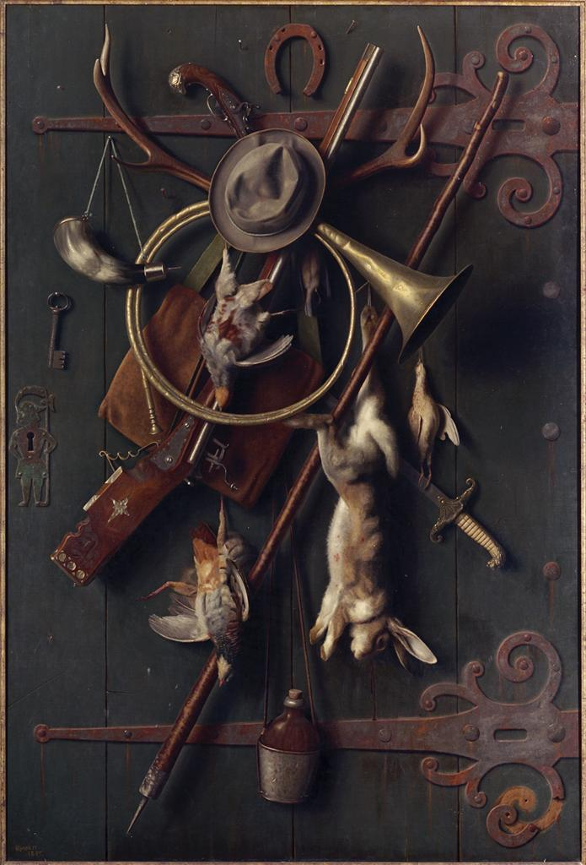
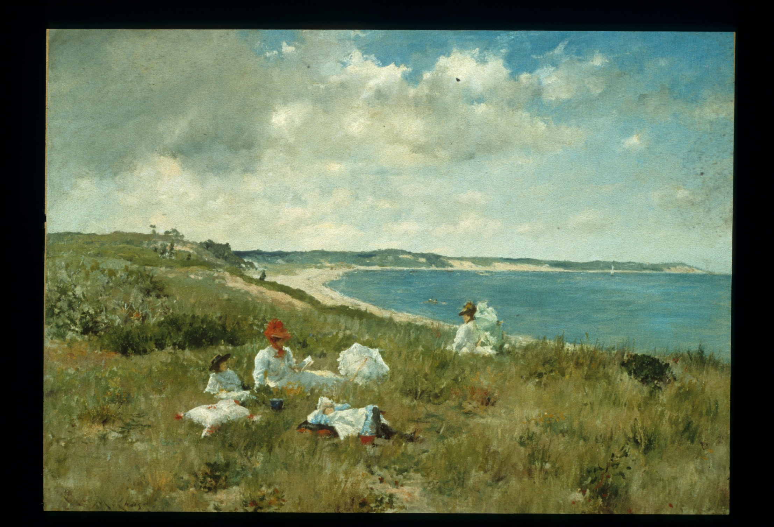
Notes:
Chase, Idle Hours, ACM

Slide 2
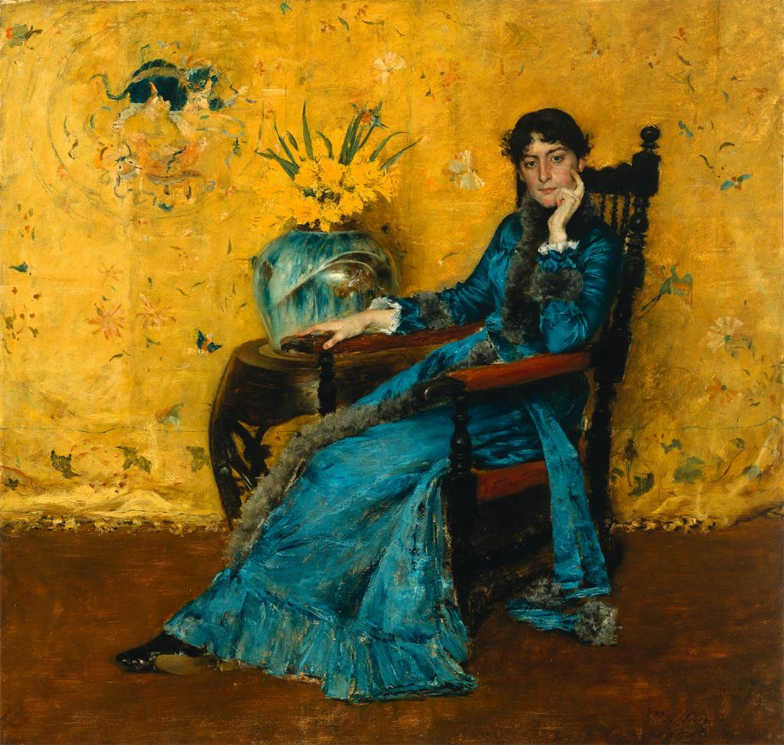

Slide 3
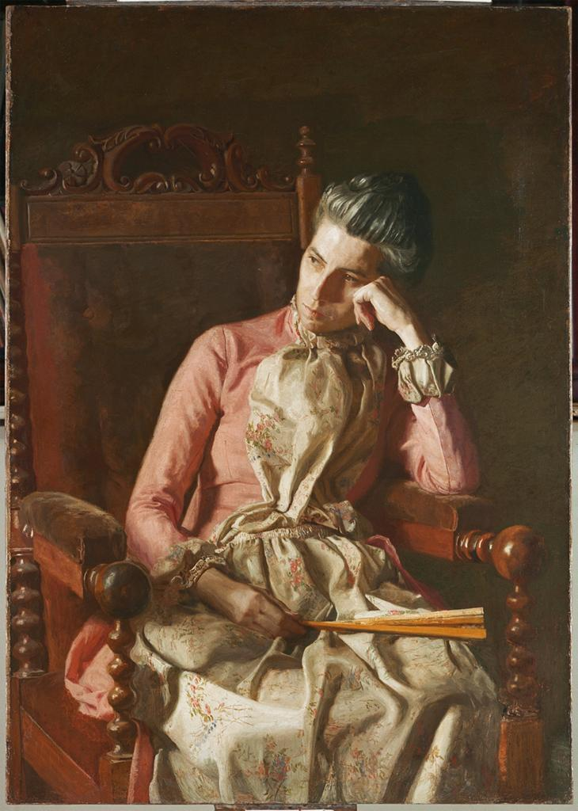
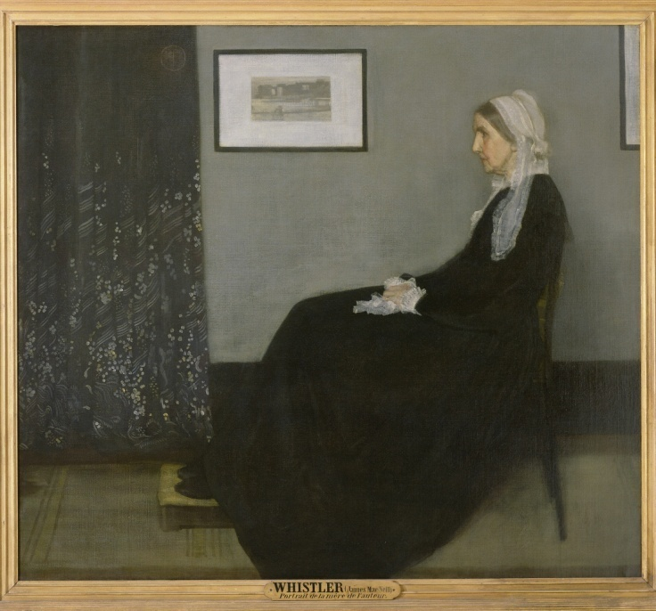

Slide 4
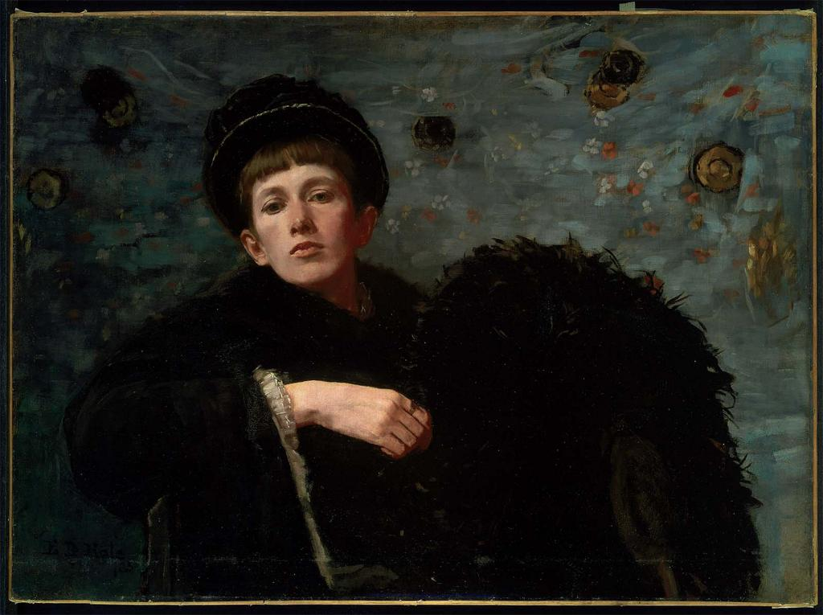

Slide 6
Notes:
Chase, Idle Hours, ACM

Slide 7
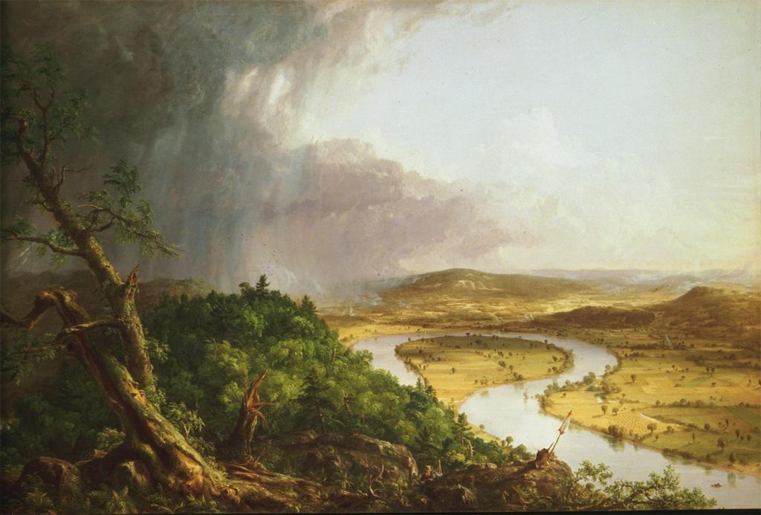
Notes:
Chase, Idle Hours, ACM

Slide 8
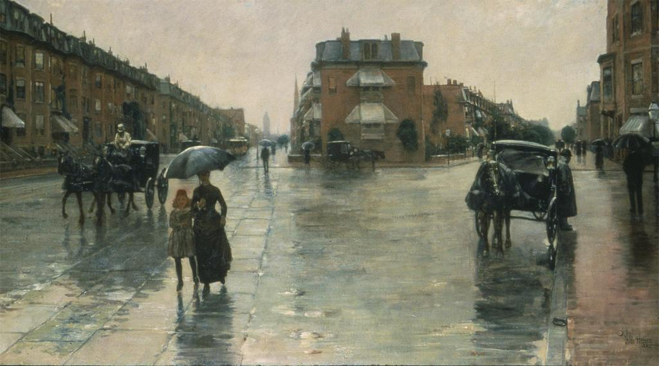

Slide 9
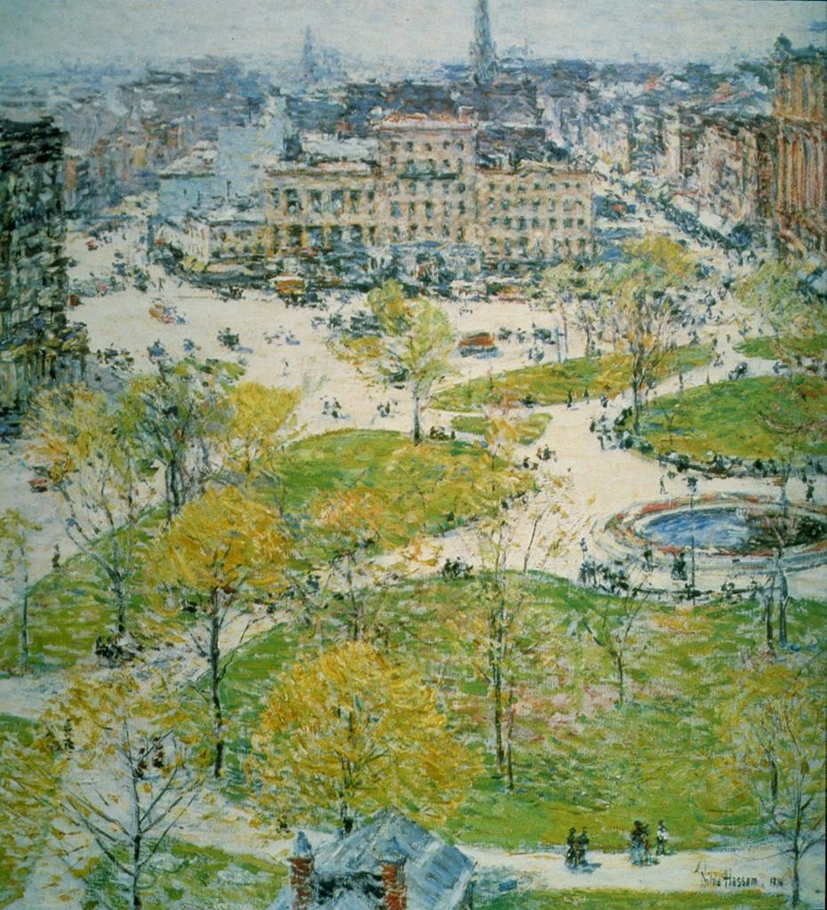
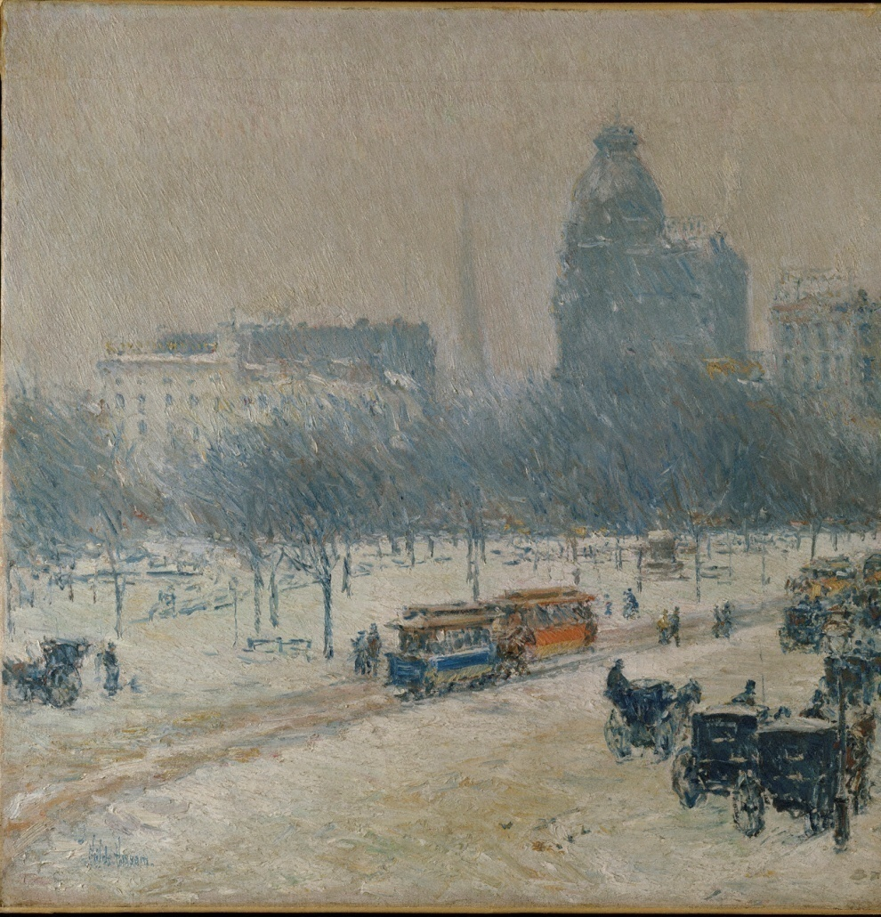

Slide 12
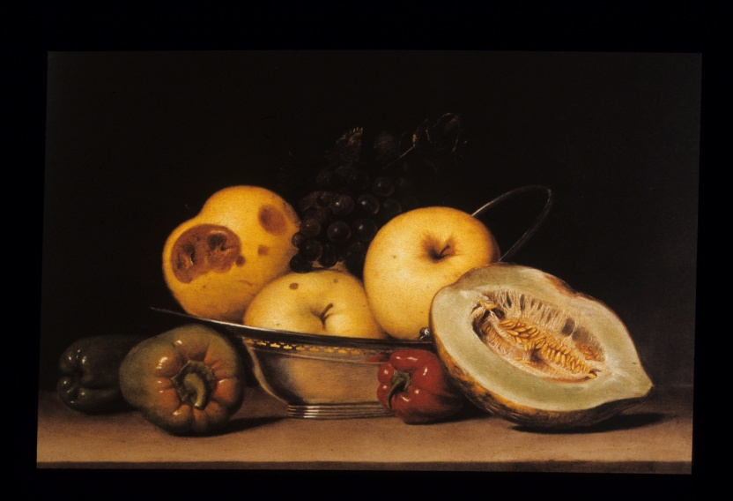
Notes:
Harnett, After the Hunt, 1885 (Fine Arts Museums of San Francisco)

Slide 13
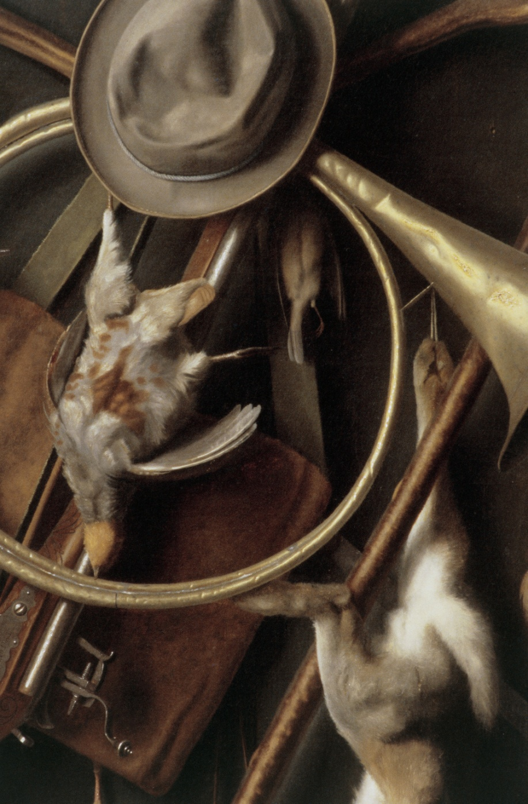
Notes:
Harnett, After the Hunt, 1885 (Fine Arts Museums of San Francisco) and detail

Slide 14
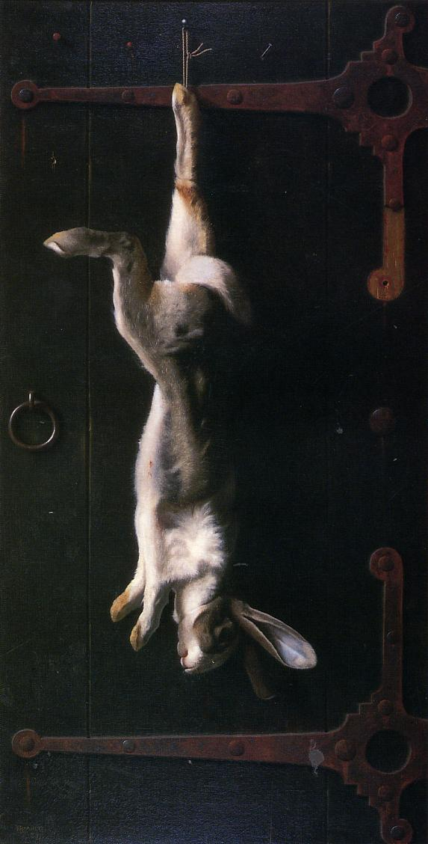
Notes:
Harnett, Trophy of the Hunt, 1885 (Carnegie Museum, Pittsburgh)

Slide 15
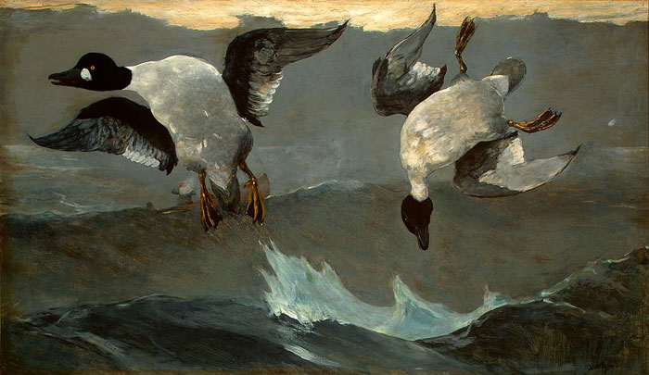

Slide 16
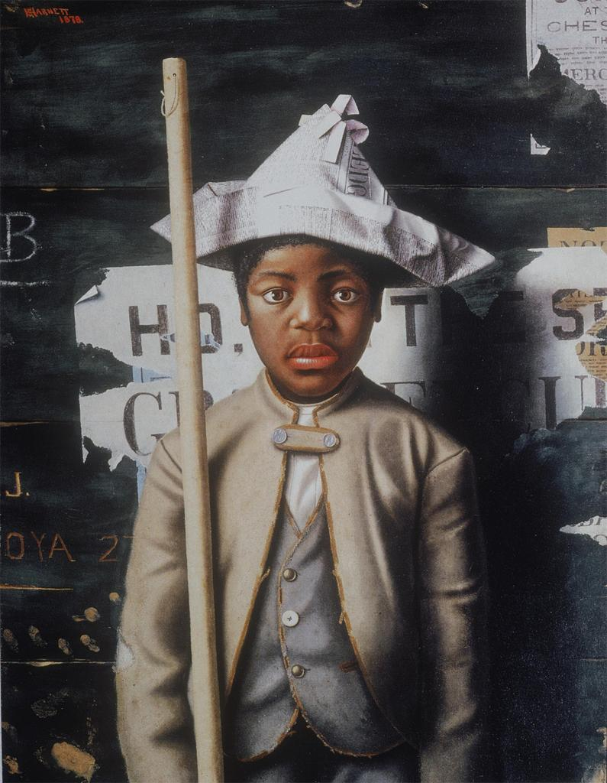
Notes:
Harnett, Attention, Company, 1878 (Amon Carter Museum)

Slide 17
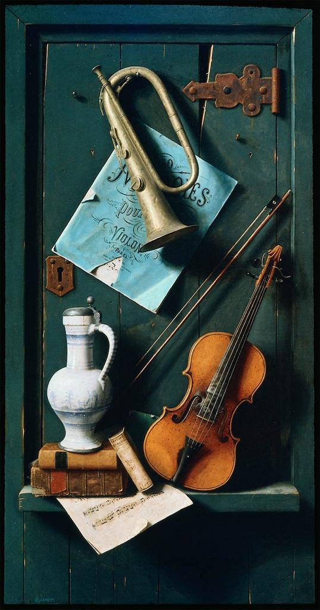
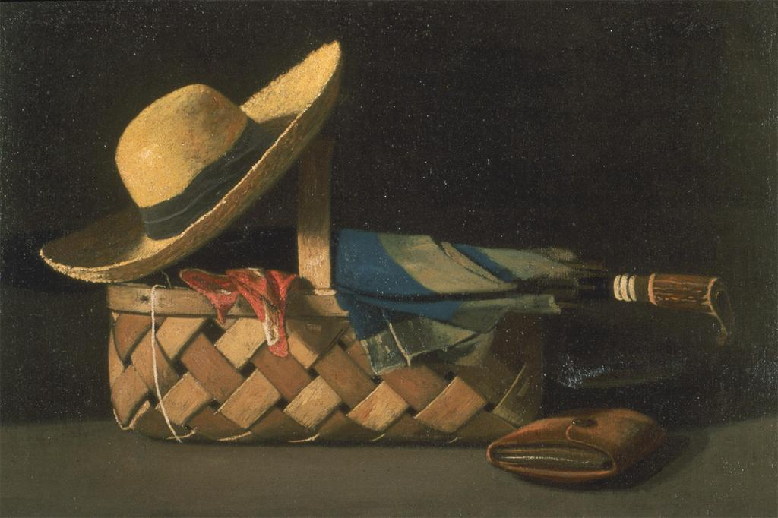
Notes:
Peto, Market Basket, Hat and Umbrella, 1890 (Layton Art Gallery) and
Harnett, Old Models, 1892 (Museum of Fine Arts, Boston)

Slide 18
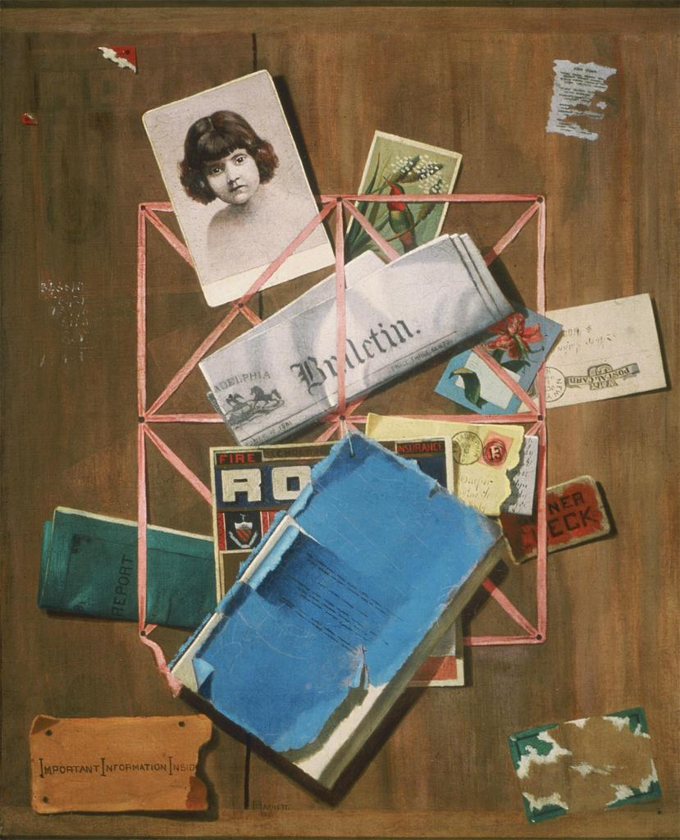
Notes:
Peto, Old Souvenirs, 1881-1900 (Metropolitan Museum)

Slide 19
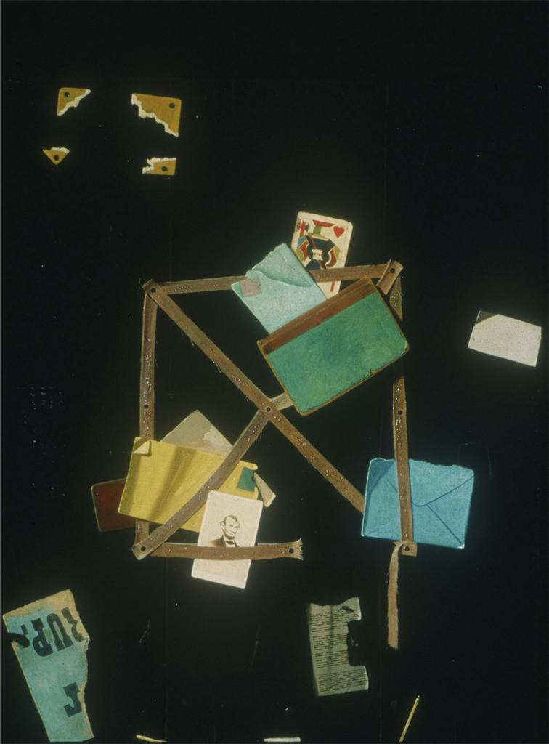
Notes:
Peto, Old Souvenirs (Met) and
Peto, Card Rack with Jack of Hearts, ca. 1900 (Cleveland Museum of Art)

Slide 20
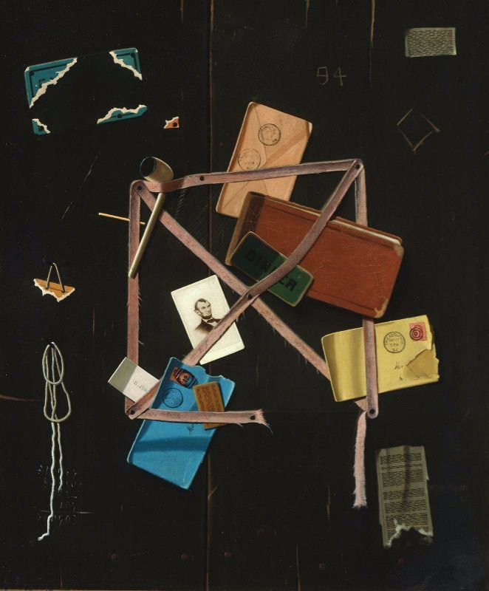
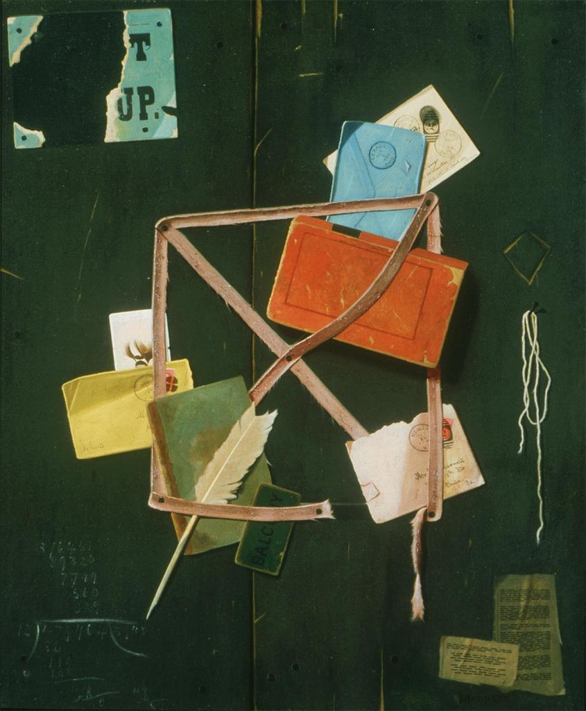
Notes:
Peto, Old Time Letter Rack, 1894 (Museum of Fine Arts, Boston) and
Peto, Old Time Letter Rack, 1894 (Museum of Modern Art, New York)

Slide 21
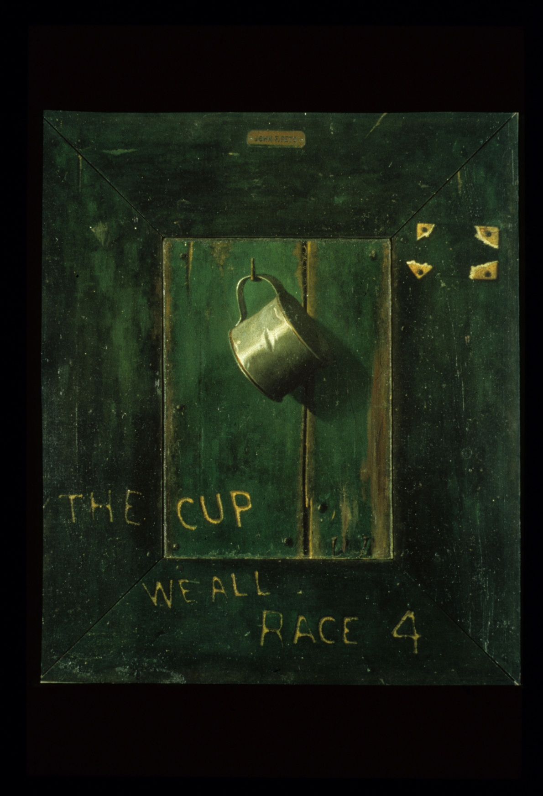
Notes:
Peto, The Cup We All Race 4, ca. 1900 (Fine Arts Museums of San Francisco)

Slide 22
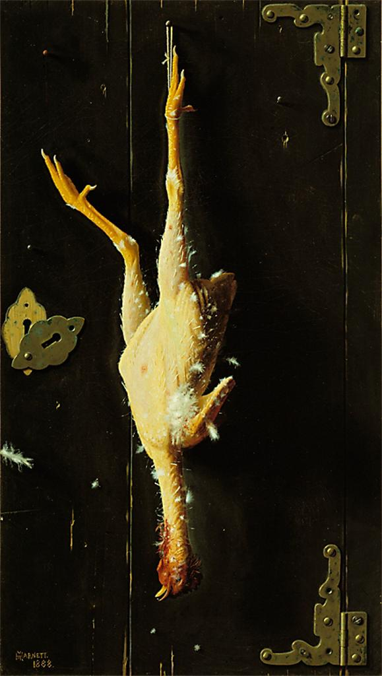
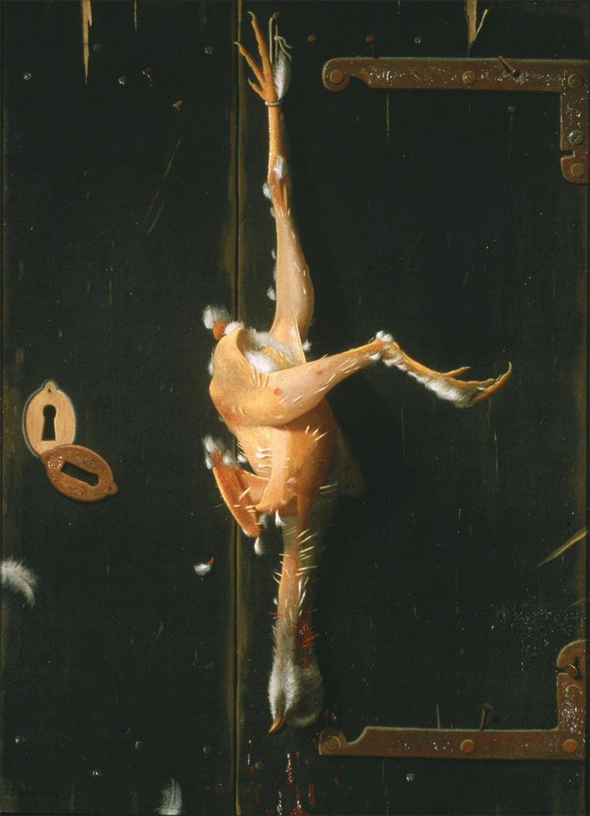
Notes:
Harnett, For Sunday’s Dinner, 1888 (Art Institute of Chicago)
Peto, For a Sunday Dinner, 1893 (Private Collection)

Slide 24
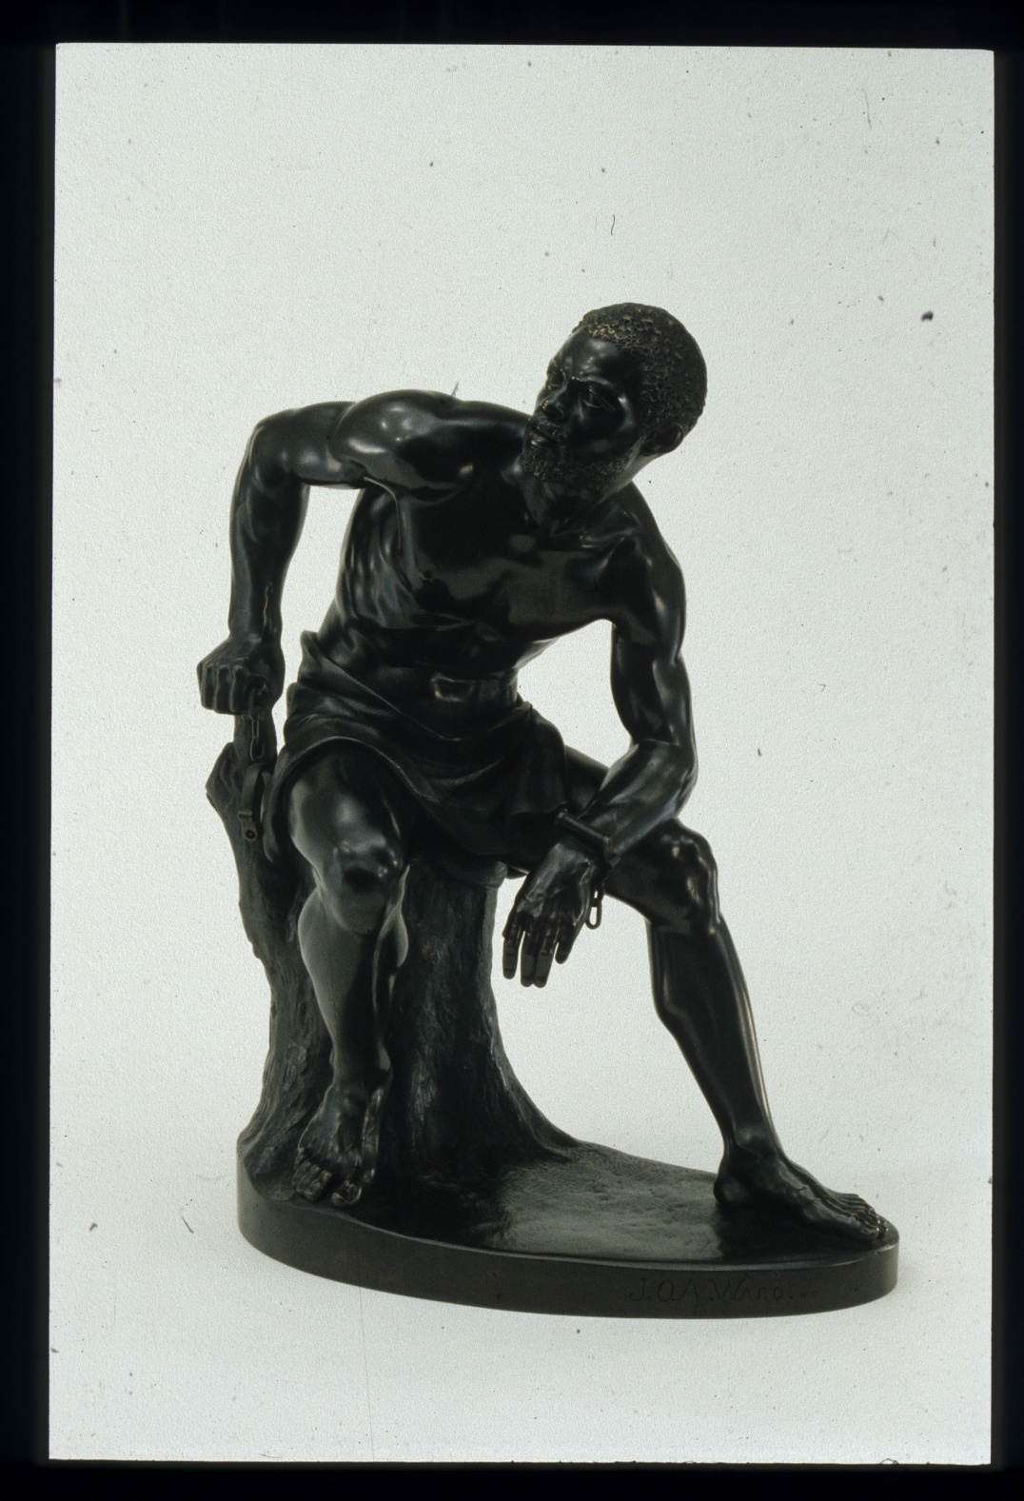
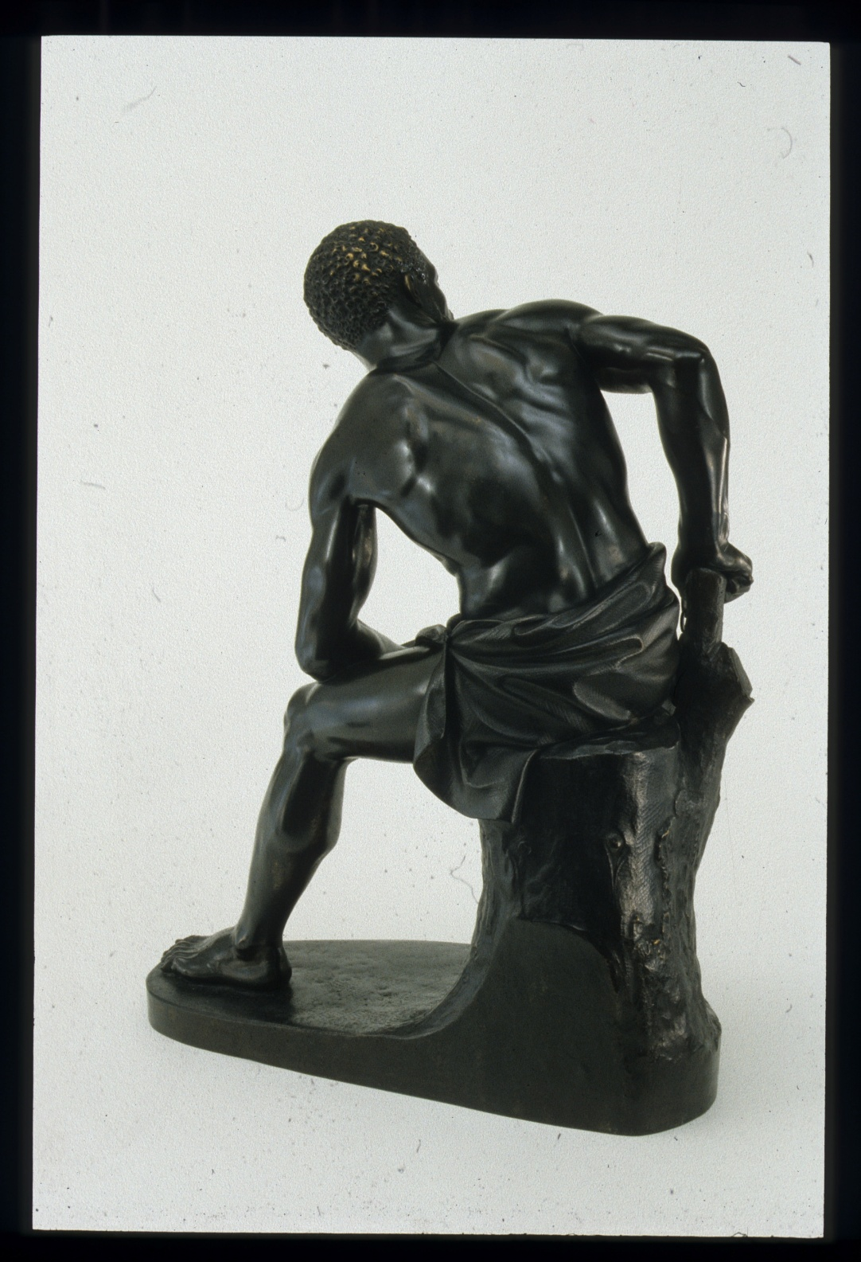
Notes:
ACM

Slide 25
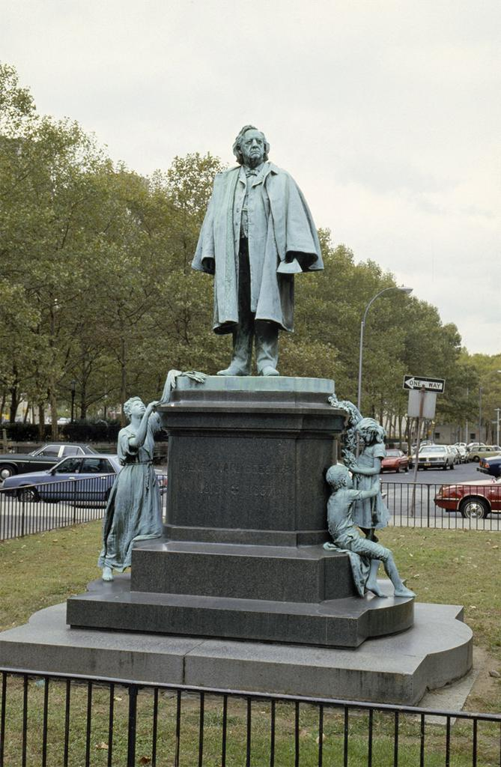

Slide 26
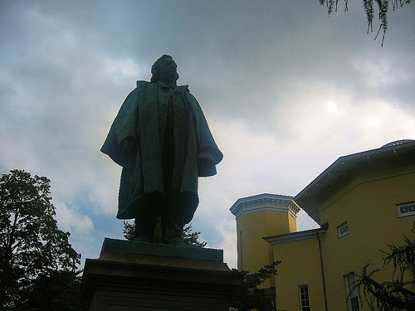

Slide 27
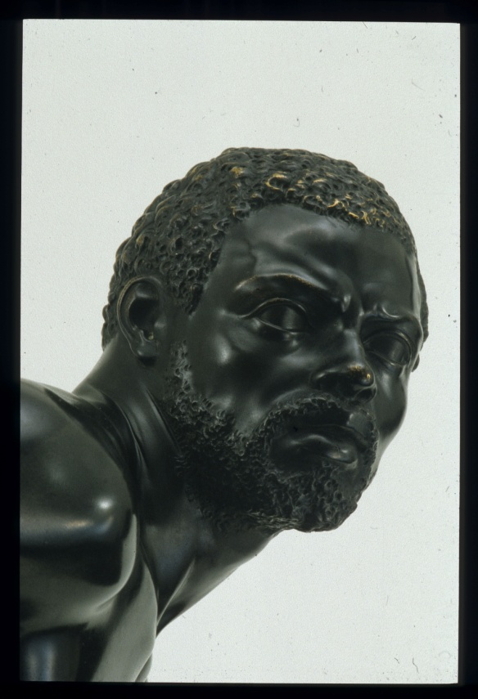
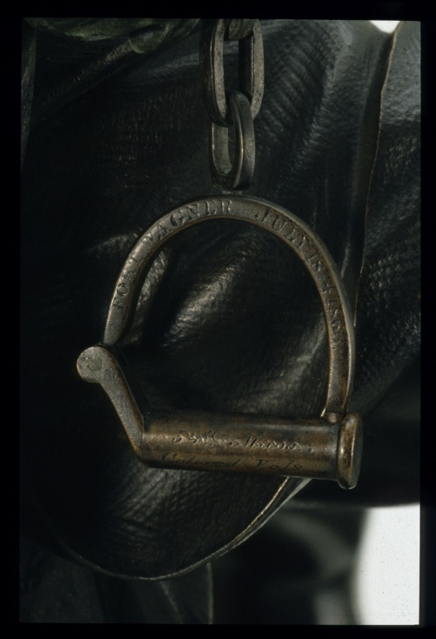
Notes:
ACM

Slide 28
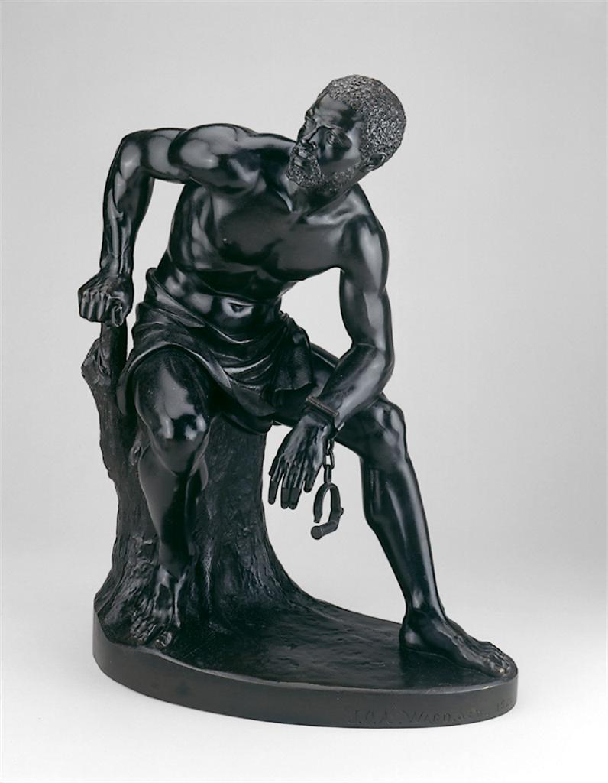
Notes:
AIC

Slide 29
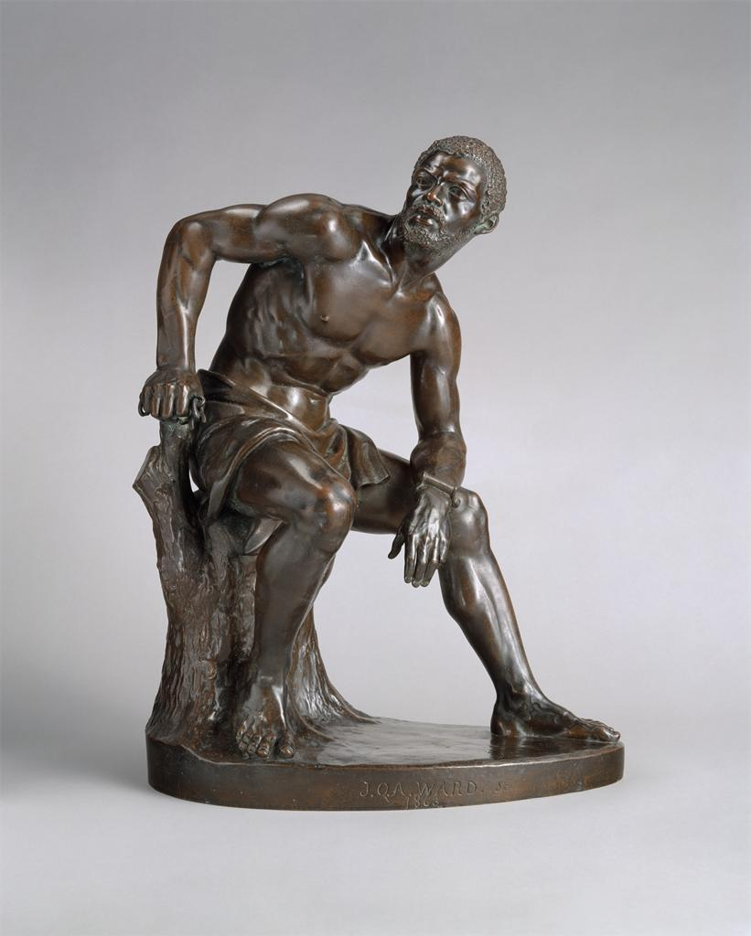
Notes:
Met

Slide 30
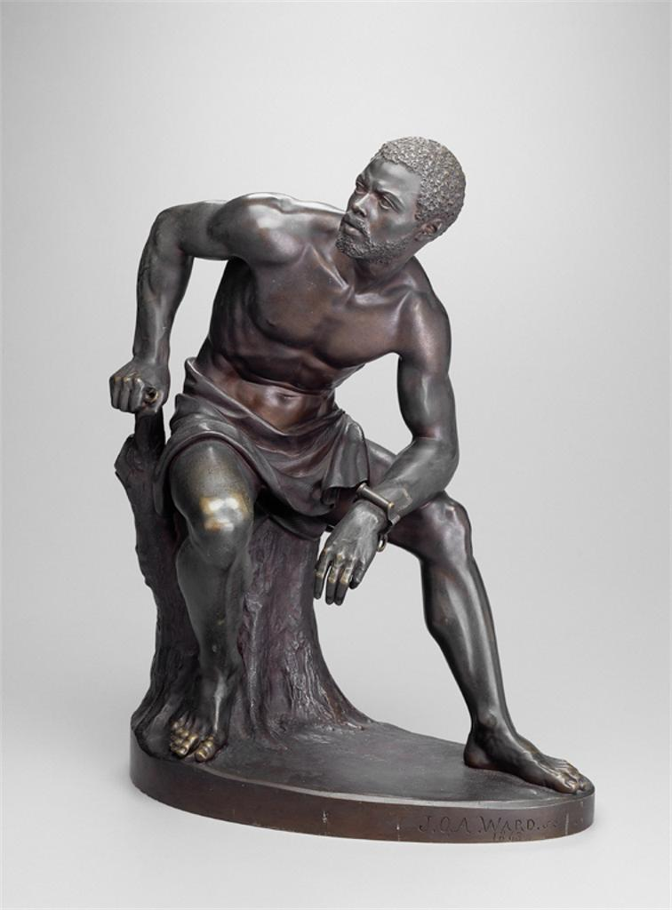
Notes:
Detroit

Slide 31
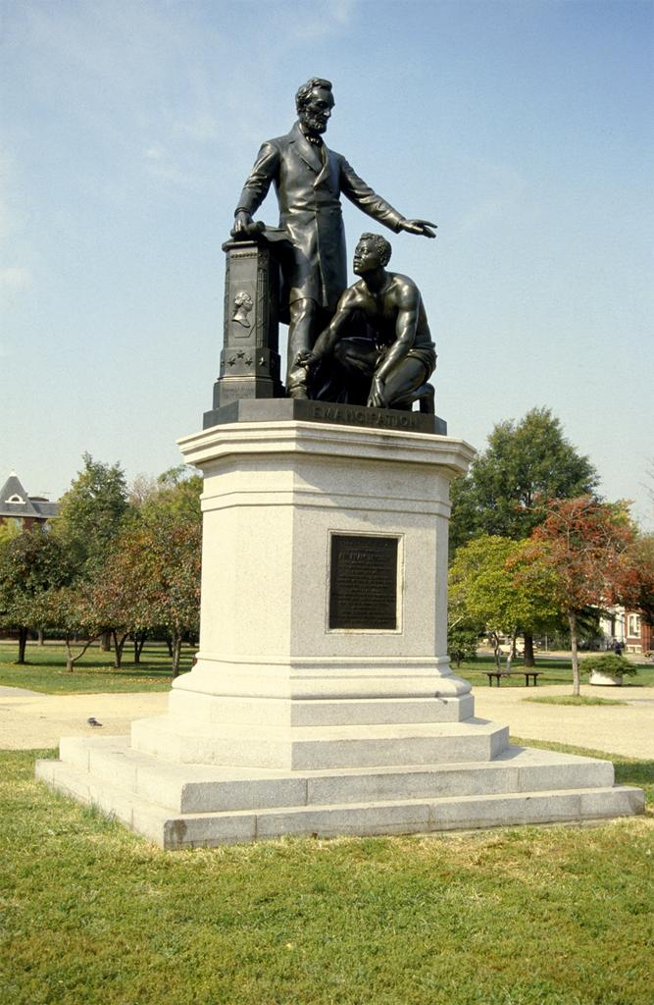
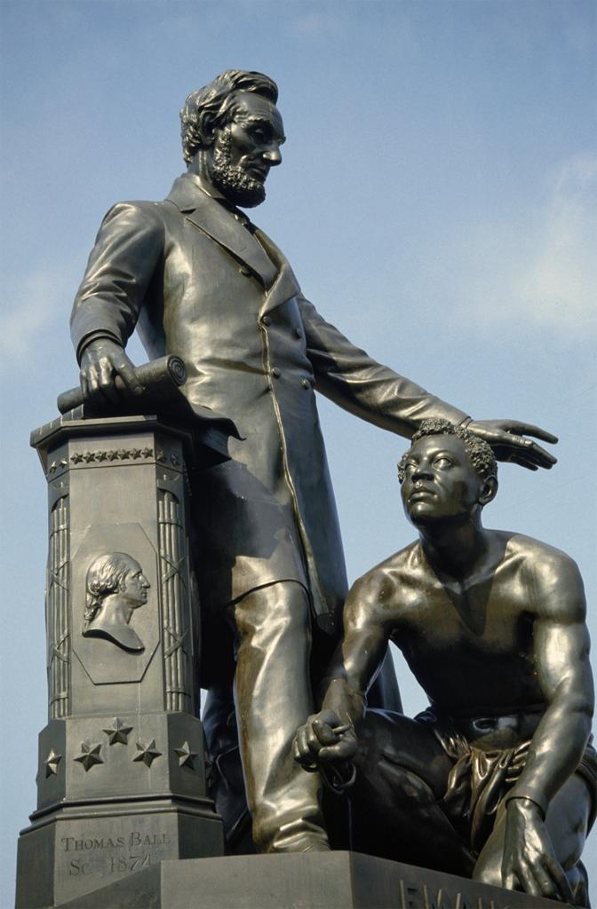
Notes:
Ball, Freeman’s Memorial

Slide 32
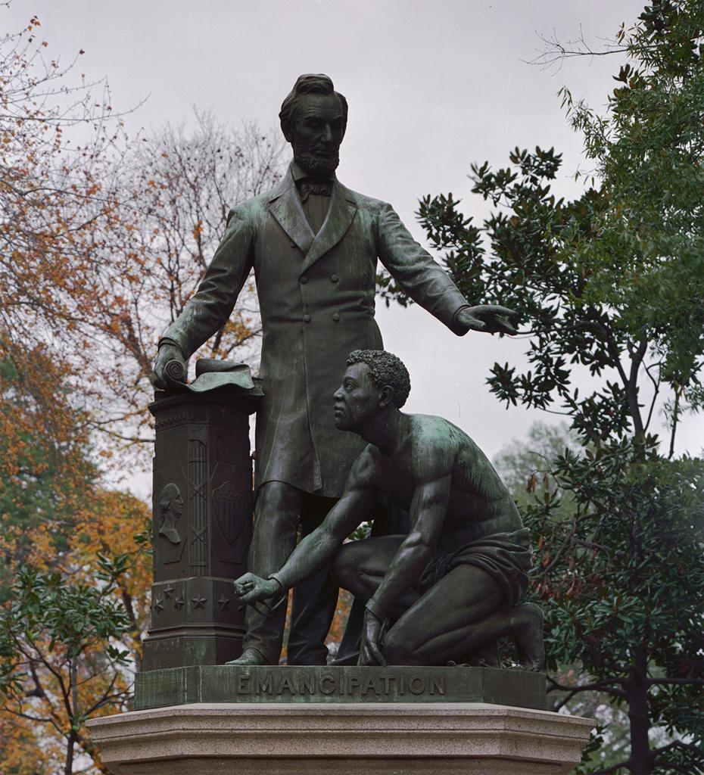
Notes:
(Met’s Freedman)

Slide 34
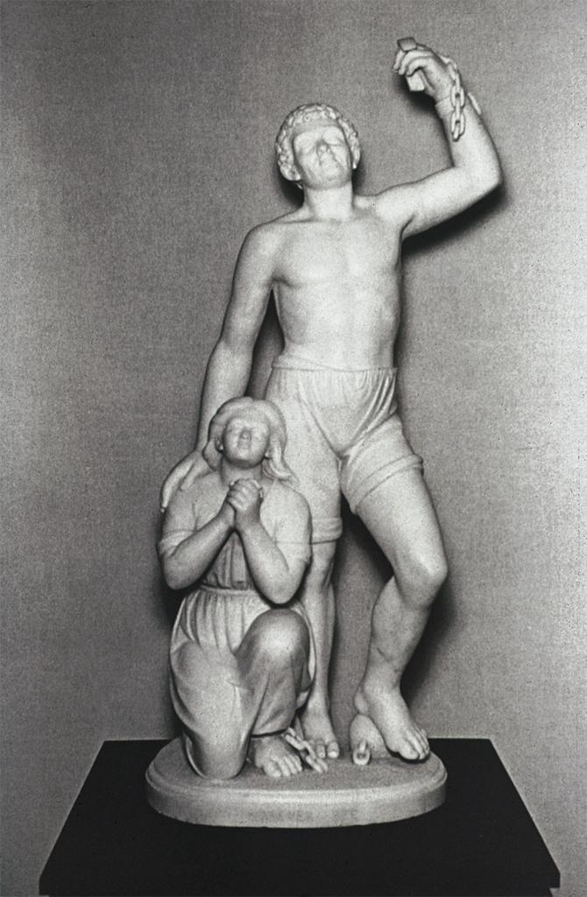
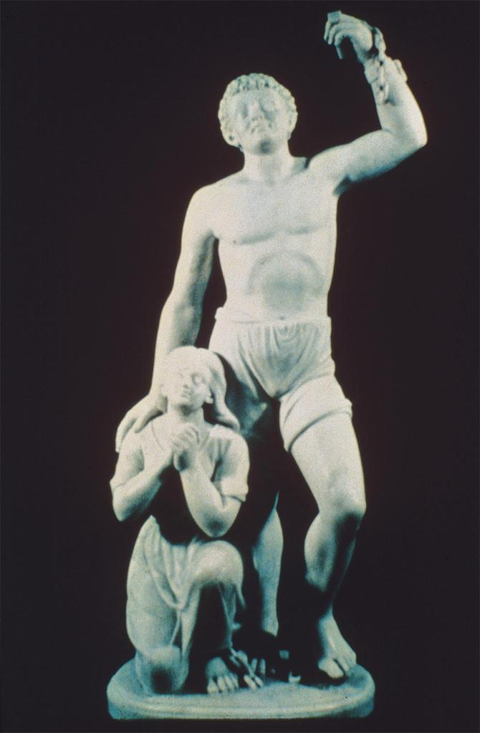

Slide 35
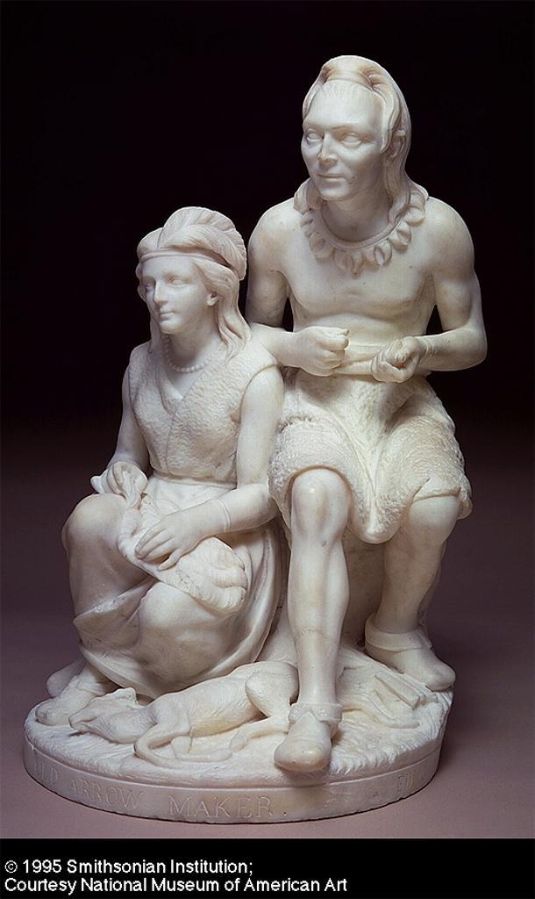
Notes:
Old Indian Arrowmaker and his Daughter 1867
Edmonia Lewis
Smithsonian American Art Museum

Slide 37
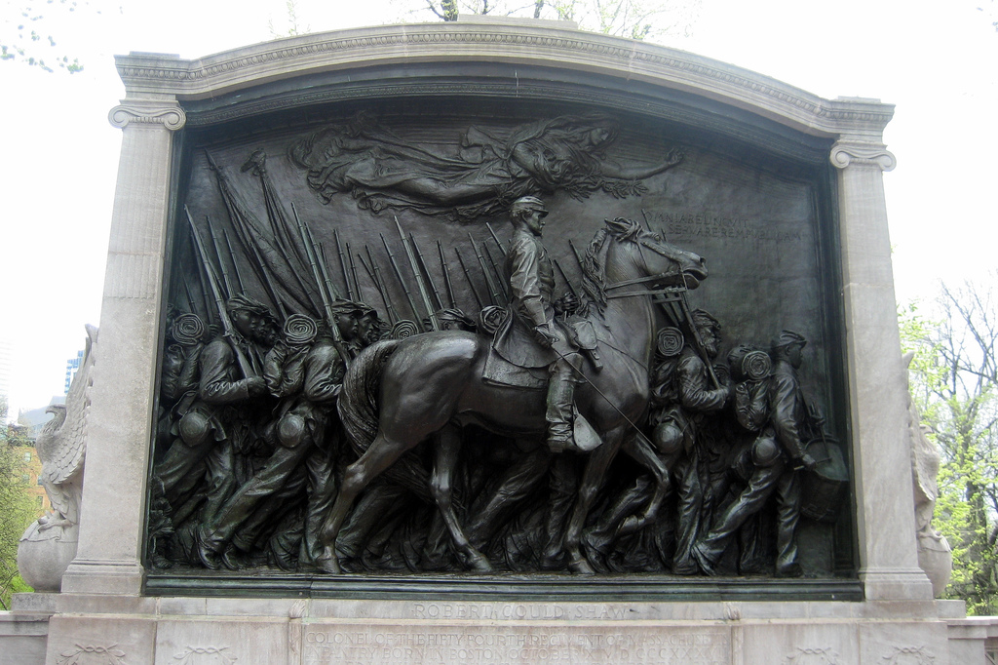
Notes:
Robert Gould Shaw Memorial 1897
Augustus Saint Gaudens
Boston Common

Slide 38
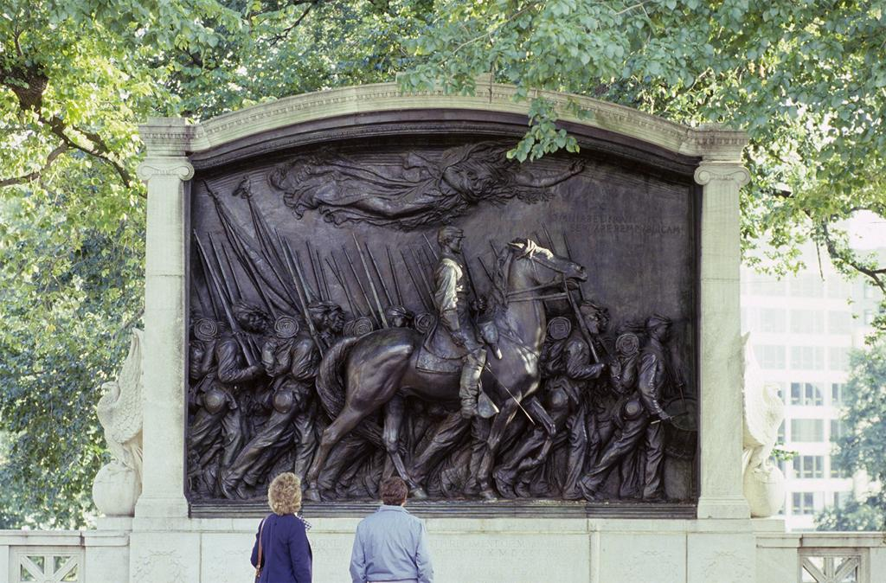
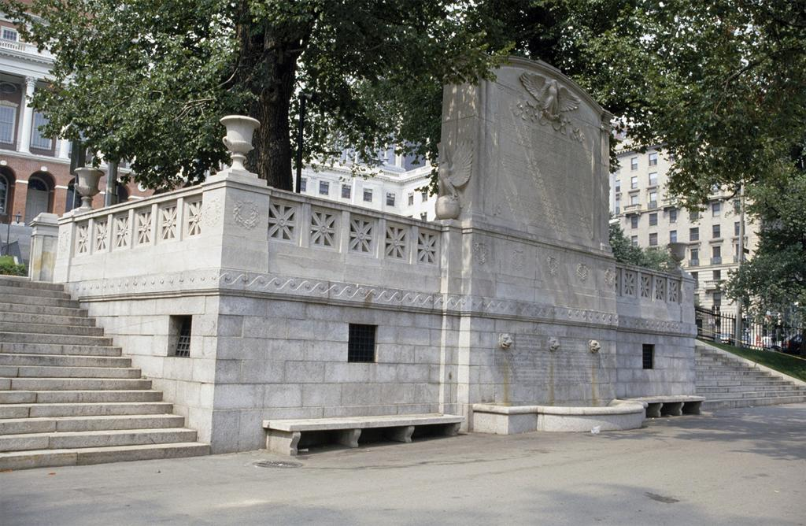

Slide 39
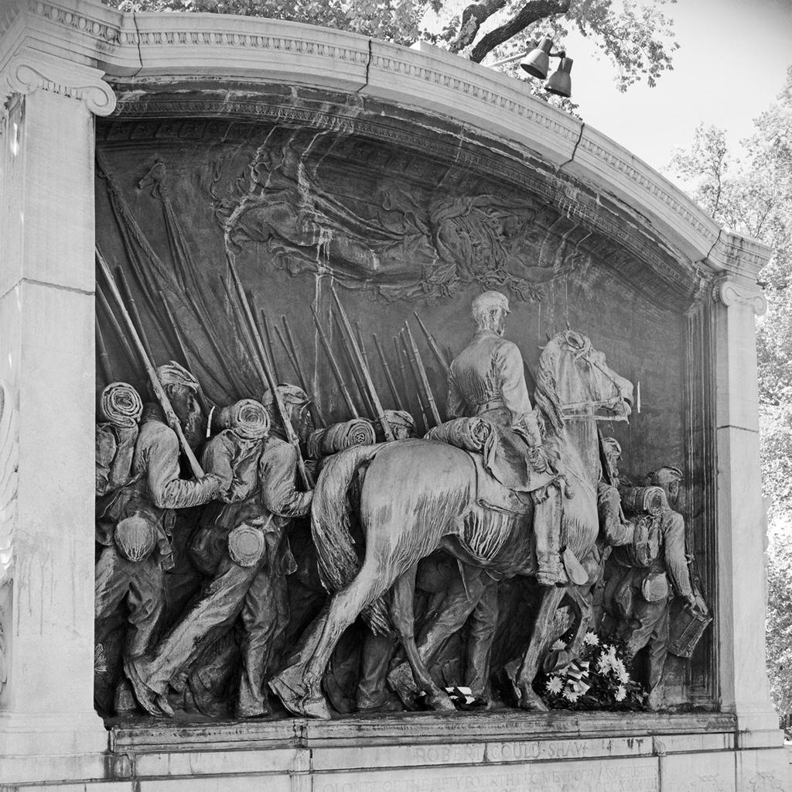

Slide 40
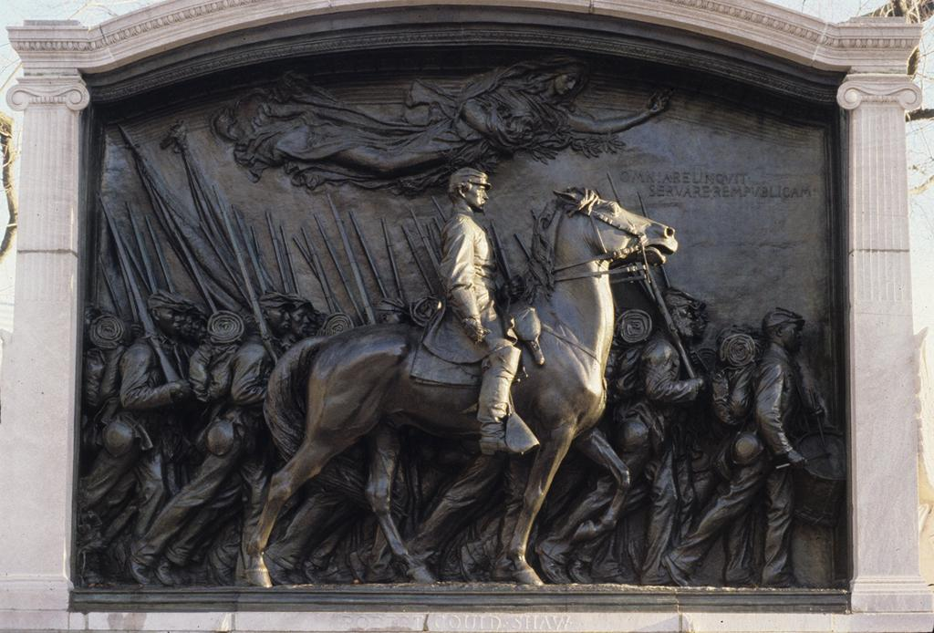

Slide 41
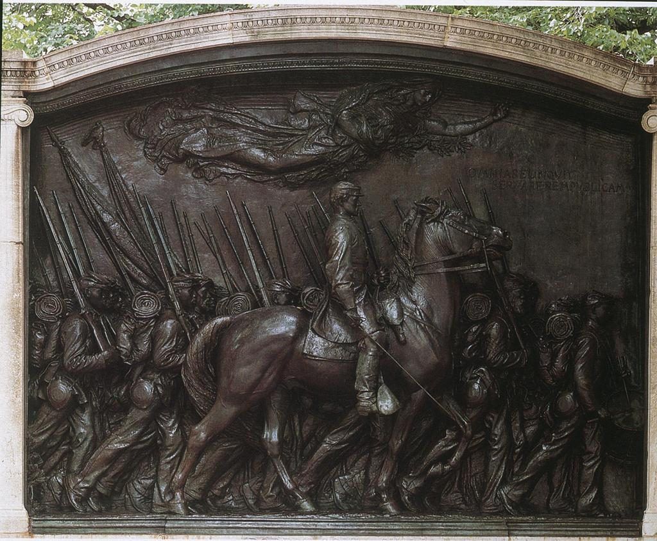
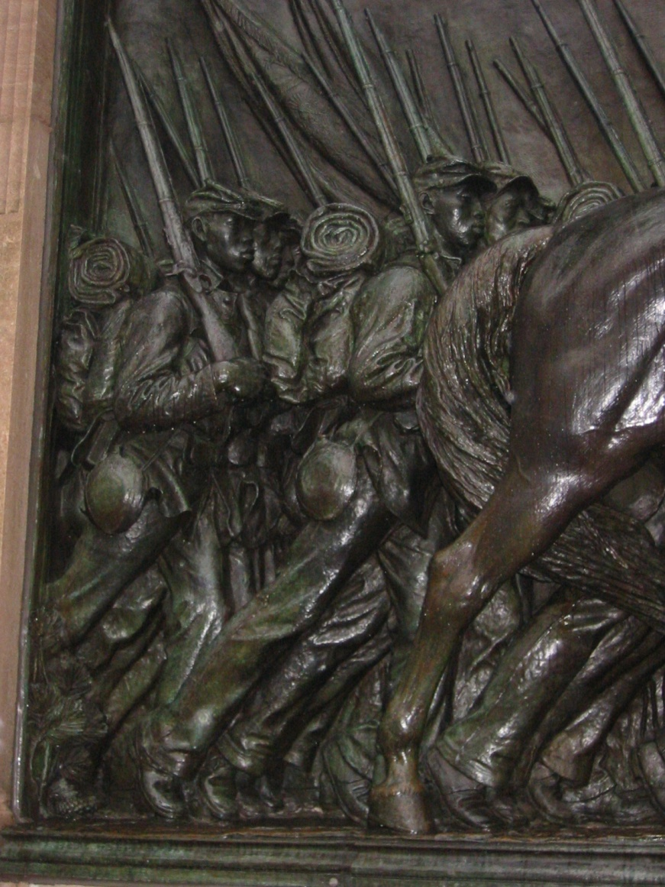
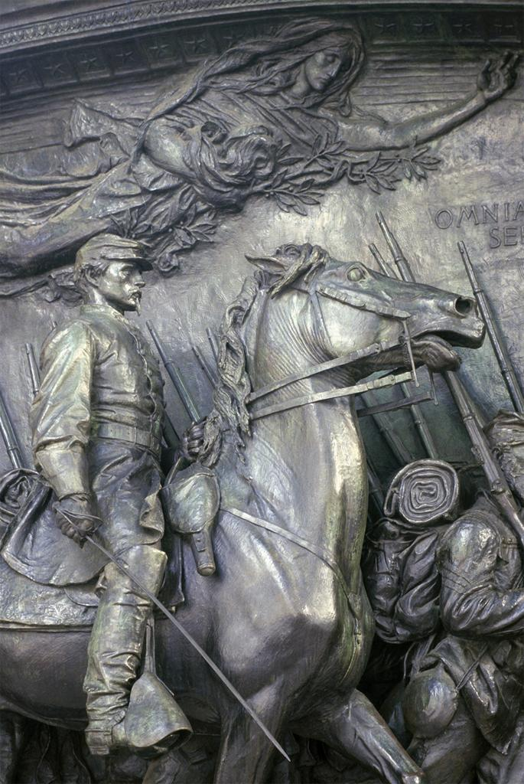

Slide 42
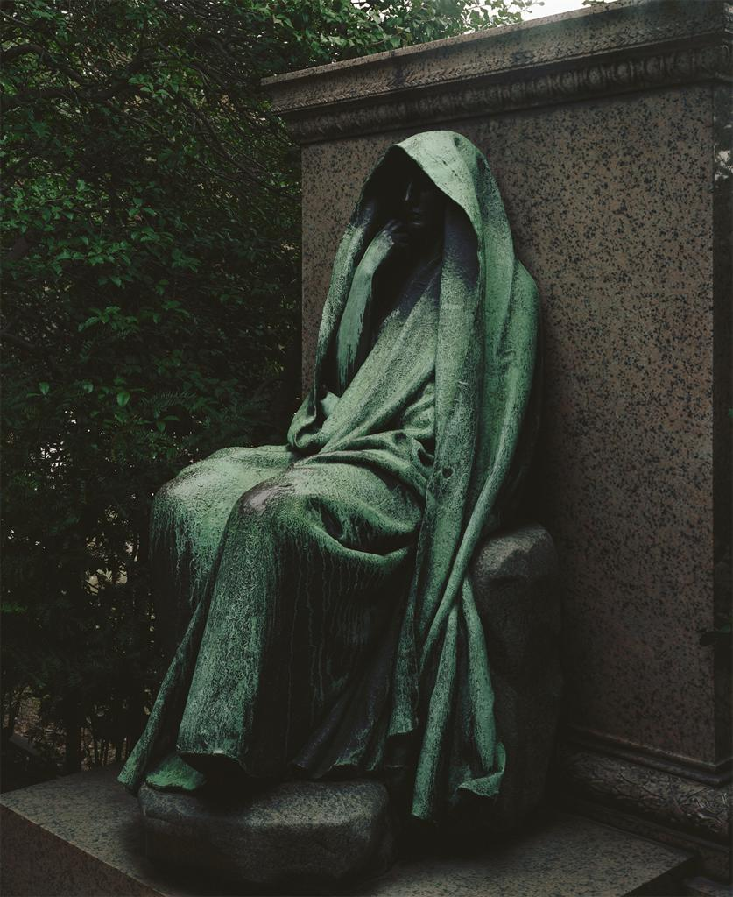

Slide 44
