Slide 1
Biochem 03 Cell Communication November 10, 2010
Function: Signal Transduction
Fast Acting Signal
NOS (small molecule)
Cortisol
Slower Acting Signals
Peptide Hormones
Steroid Hormones
Second Messengers
IP3
Ca(II)
Calmodulin

Slide 2
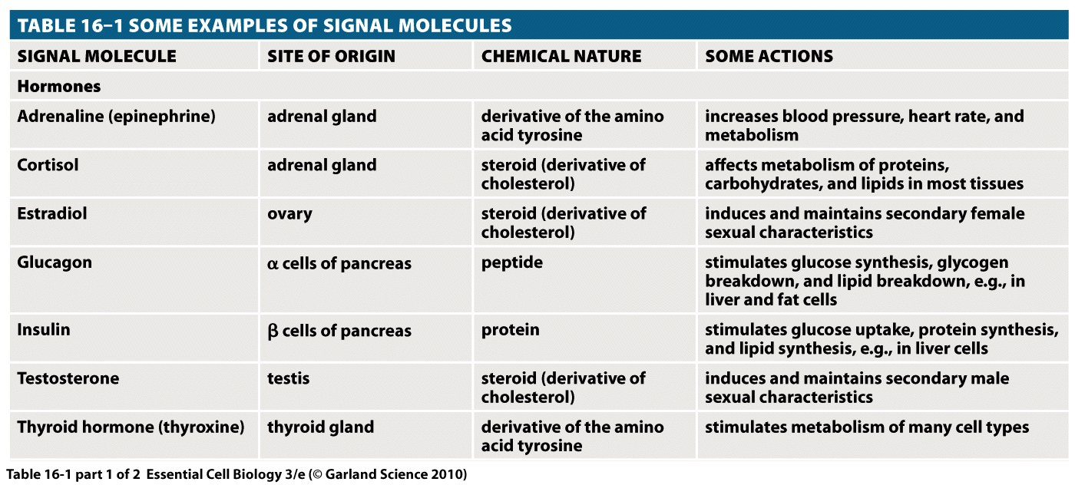

Slide 3
Hormones enter cells through different methods depending on their chemical nature
Peptide hormones
Steroid hormones

Slide 4
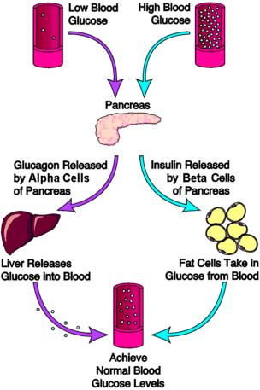
Peptide Hormones---Insulin and Glucagon
Blood glucose is very highly regulated
Target 70-180 mg/dl 100 ml
Glucose too high? (hyperglycemia)
Insulin is released from the pancreas to stimulate the uptake of glucose into fat cells
Glucose too low (hypoglycemia)
Glucagon is released from pancreas and causes liver to release stores of glucose into blood

Slide 5
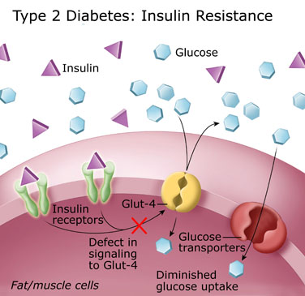
How does Insulin Work?
Insulin binds to a receptor which signals a transporter to increase the transport of glucose across the membrane
In type 2 diabetes, the signal to the transporter does not work, and there is diminished glucose uptake, must take more insulin

Slide 6
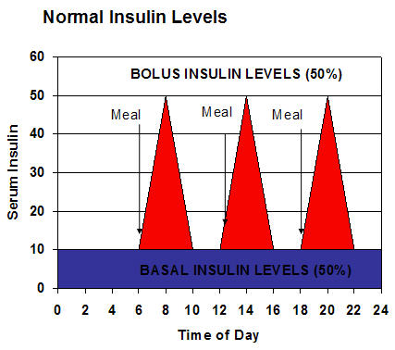
How does Insulin Work?
Insulin
50% in the basal level (replaced by slow acting insulins)
50% in the bolus (after meals) replaced by fast acting insulins)
Maximum insulin is 1-2 Units per kg per day
Individual: 100 kg,
100 to 200 units per day
50 units in basal
50 units in bolus

Slide 7
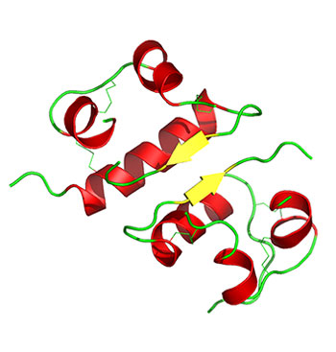
What is insulin?
Insulin (shown here as a dimer) is a 51 amino acid anabolic peptide-hormone and consists of two chains (a and b) connected by disulfide bonds.
http://www.3dchem.com/molecules.asp?ID=196#
* The primary sequence insulin was determined by British molecular biologist Frederick Sanger. It was the first protein for which the sequence was completely determined. For this Sanger was awarded the Nobel Prize in Chemistry in 1958.
* In 1967, after decades of work, Dorothy Crowfoot Hodgkin determined the spatial conformation of the molecule, by means of X-ray diffraction studies. She also was awarded a Nobel Prize.

Slide 8
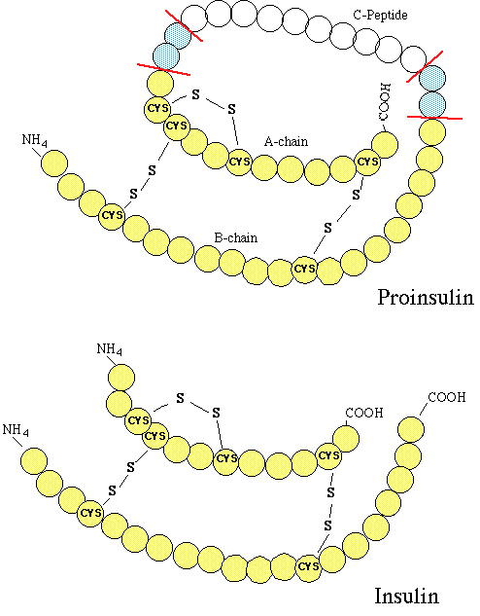
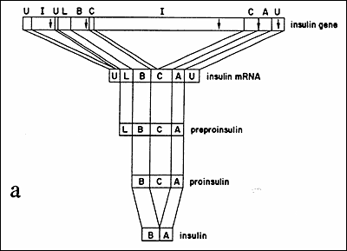
Insulin is expressed as a preproInsulin
Regulation of insulin
The middle amino acids are excised from a and b

Slide 9
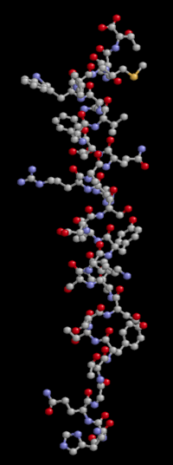
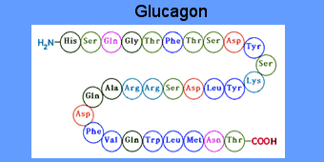
What is glucagon?
29 amino acid hormone

Slide 10
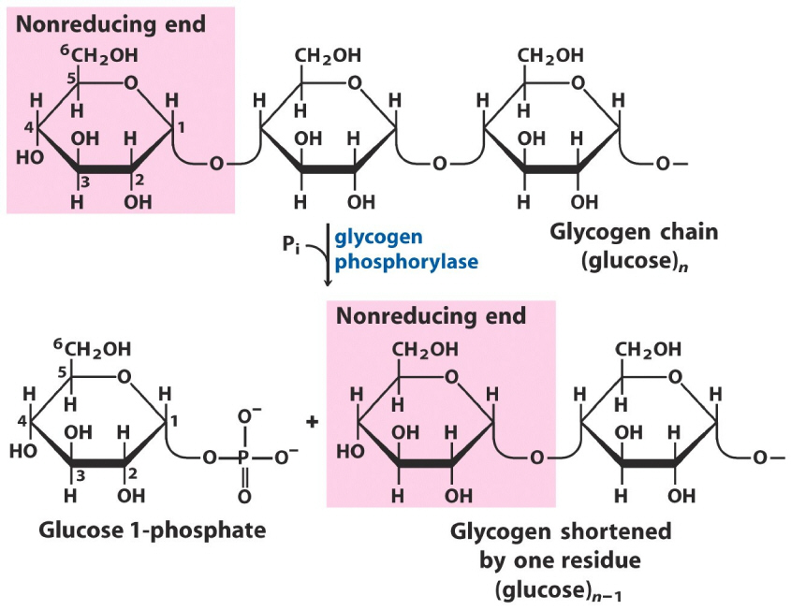
What does glucagon do?
sti
“Glucose is gone signal”
Glucagon stimulates the breakdown of storage polysaccharide known as glycogen in liver and muscles.

Slide 11
Peptide Hormones---Vasopressin
Vasopressin is also known as arginine vasopressin (AVP), and antidiuretic hormone (ADH)
Vasopressin is a peptide hormone that contains just nine amino acids
Cys-Tyr-Phe-Gln-Asn-Cys-Pro-Arg-Gly
The precursor protein molecule is 164 amino acids and is made in the hypothalamus
The processes vasopressin is stored in vesicles at the posterior pituitary
While most of the vasopressin in the posterior pituitary will be released into the blood stream; some of it is also released directly into the brain

Slide 12
Peptide Hormones---Vasopressin Function
Primary role of vasopressin is to regulate the body's retention of water; it is released when the body is dehydrated and causes the kidneys to conserve water, thus concentrating the urine and reducing urine volume
In high concentrations, it also raises blood pressure by inducing moderate vasoconstriction
The main stimulus for secretion of vasopressin is increased osmolality (?) of blood plasma. Reduced volume of extracellular fluid also has this effect, but is a less sensitive mechanism
Osmolality =
The AVP that is measured in peripheral blood is almost all derived from secretion from the posterior pituitary gland

Slide 13
Peptide Hormones---Vasopressin Function
In addition, vasopressin has a variety of neurological effects on the brain, having been found, for example, to influence pair-bonding in small mammals
Evidence for this comes from experimental studies in several species, which indicate that the precise distribution of vasopressin and vasopressin receptors in the brain is associated with species-typical patterns of social behavior
In particular, there are consistent differences between monogamous species and promiscuous species in the distribution of vaso. receptors, and sometimes in the distribution of vasopressin-containing axons, even when closely-related species are compared

Slide 14
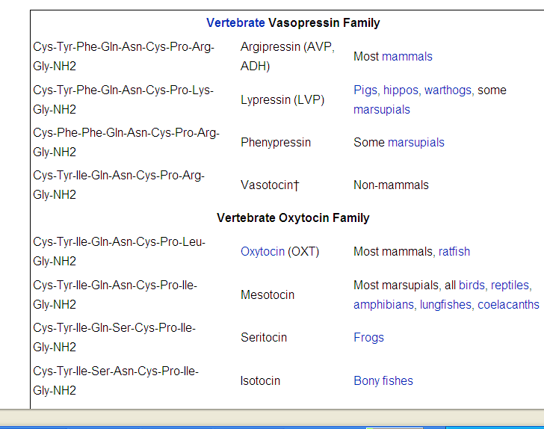
Vasopressin is very similar to another class of hormones, oxytocin
Peptide hormones
Steroid hormones

Slide 15
Both peptides cyclize through the two cysteine residues
Oxytocin: cys-tyr-ile-gln-asn-cys-pro-arg-gly
Vasopressin: cys-tyr-phe-gln-asn-cys-pro-arg-gly

Slide 16
Oxytocin’s Function
Primary:
powerful uterine contractions at birth
Lactose release from the mammary glands (let down reflex)
Secondary (neurological)
Oxytocin effects in humans were recently demonstrated by a behavioural study showing selectively increased trust after hormone administration (Kosfeld, M., et al. (2005). Nature, 435: 673-676)
neural mechanism for the effects of oxytocin in social cognition in humans and provides a potential therapeutic approach to social anxiety currently being tested in social phobia and autism (oxytocin nasal spray)

